Slide 1



2022 One Health
Notes:
Intro: 5 min.
PI’s

Slide 2
Outline
Introduction - 4 min
Brianna Beechler (Assistant Professor)
Research Project Outline & Site Description - 5 min
Kacy Woodley (Ph.D. Student) & Bryce Gabbard (Post-baccalaureate Student)
Student Summaries of in progress outcomes
  Antibiotic Resistance - 5 min
Holden Ard (Undergrad Student)
  Waterborne pathogens Giardia, Cryptosporidium and Leptospirosis - 10 min
Daniel Capasso (Vet Student), Mariangel Aleman Torres (Undergrad Student) & Kacy Woodley (Ph.D. student)
  Tickborne disease - 5 min
Daniel Capasso (Vet Student)
Conclusions and Future Goals - 4 min
Justin Sanders (Assistant Professor)
Student Opportunities 2023 - 2 min
Brianna Beechler (Assistant Professor)

Slide 3
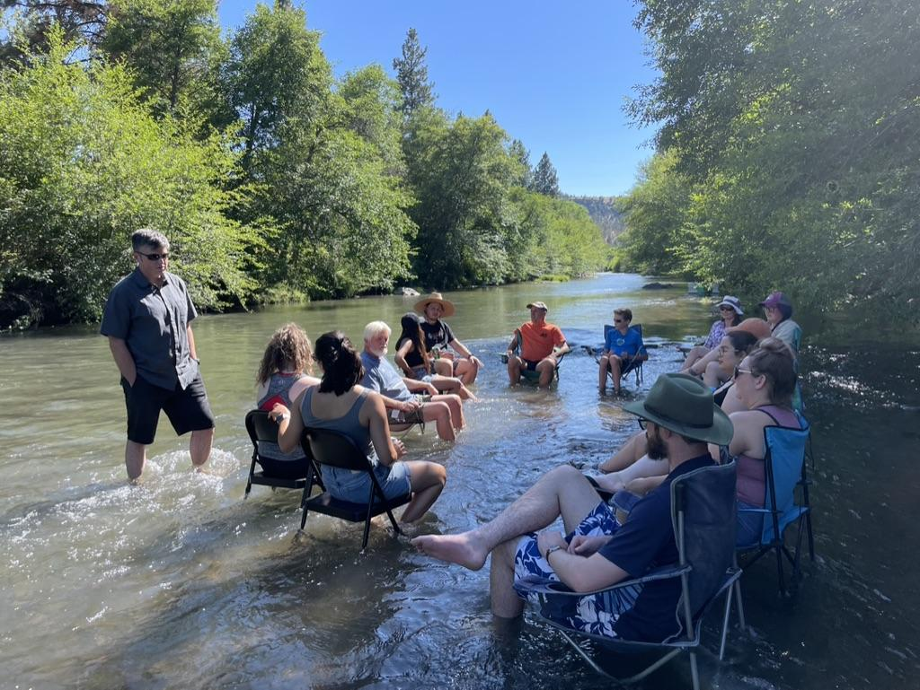
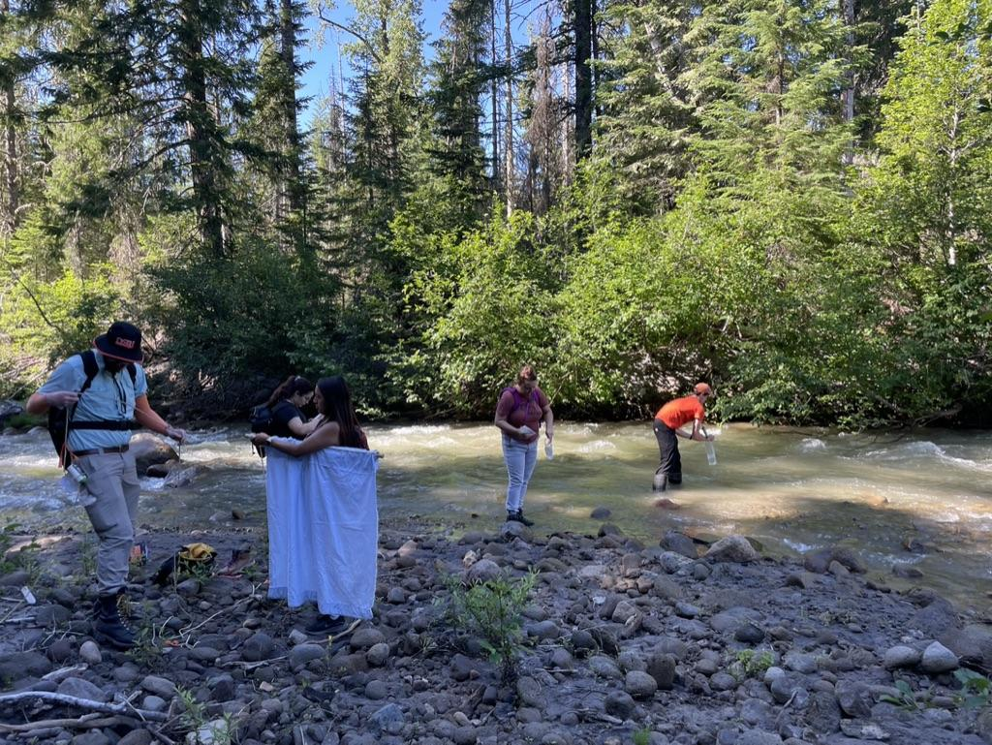
Program Goals
Education
Research

Slide 4
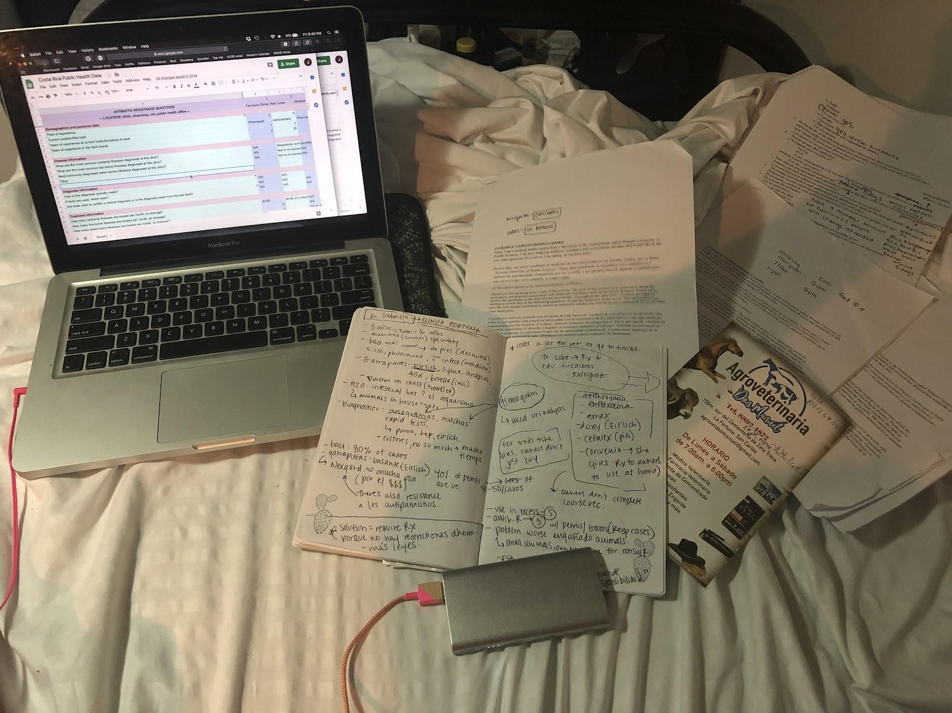
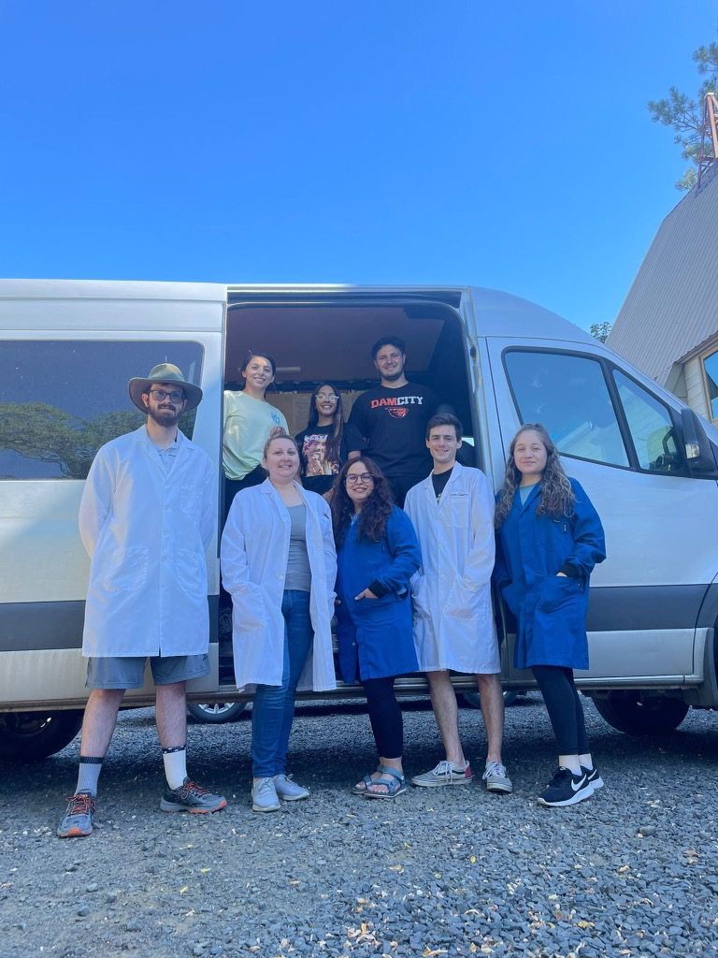
Program Goals
Education
Interdisciplinary
Human health
Animal health
Environmental health
Research literacy

Slide 5
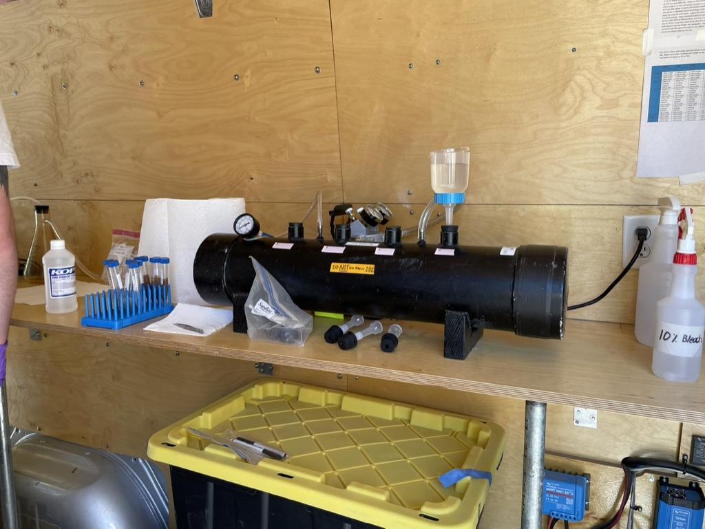
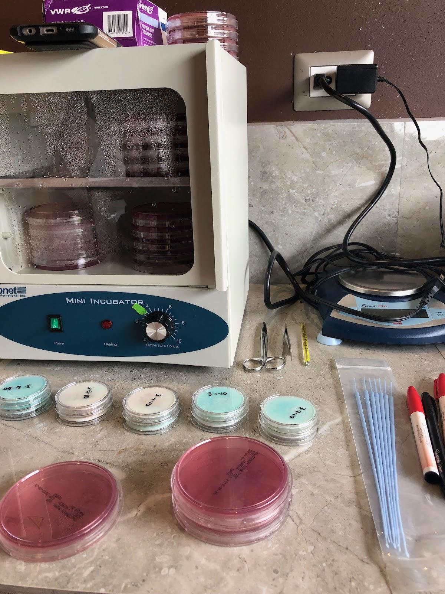
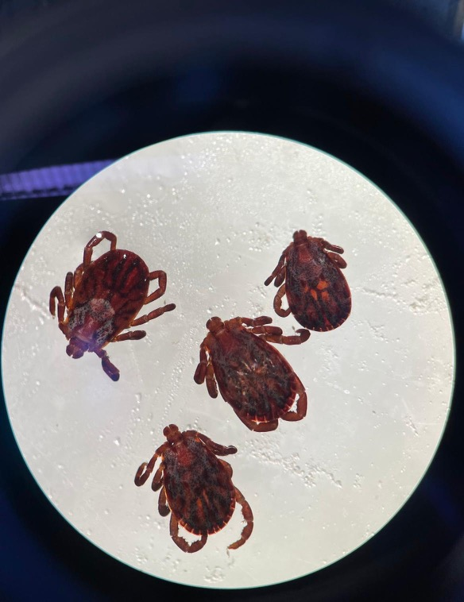
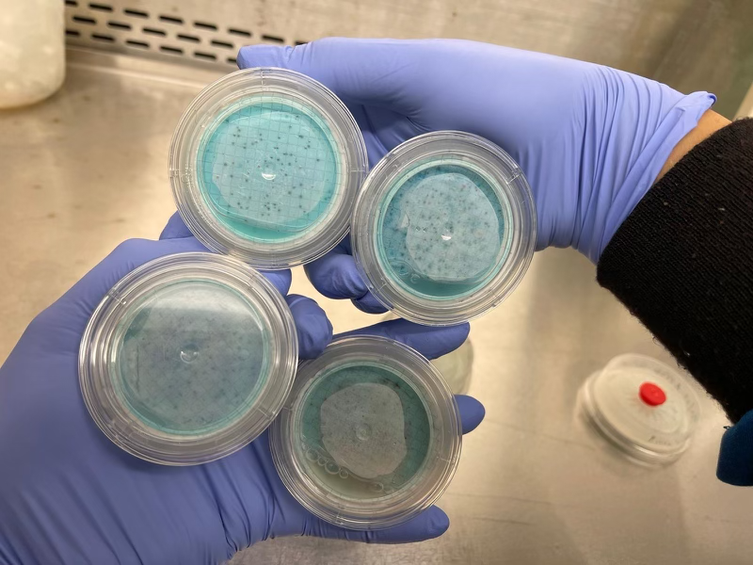
Program Goals
Research
One Health problems:
Antimicrobial resistance
Vectorborne diseases
  Ehrlichia, Anaplasma, Lyme Disease
Waterborne diseases
  Giardia, Cryptosporidium, Leptospirosis

Slide 6

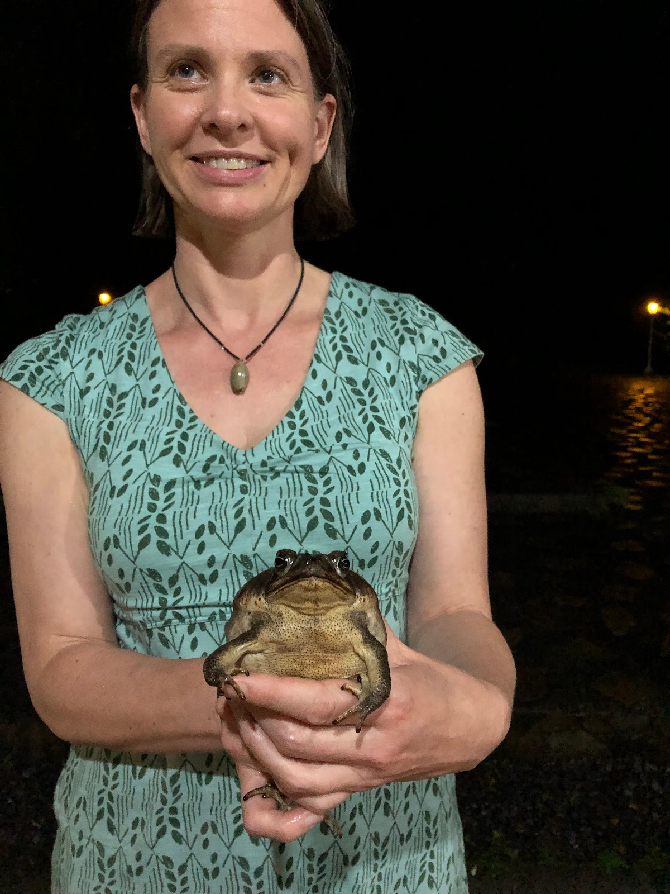
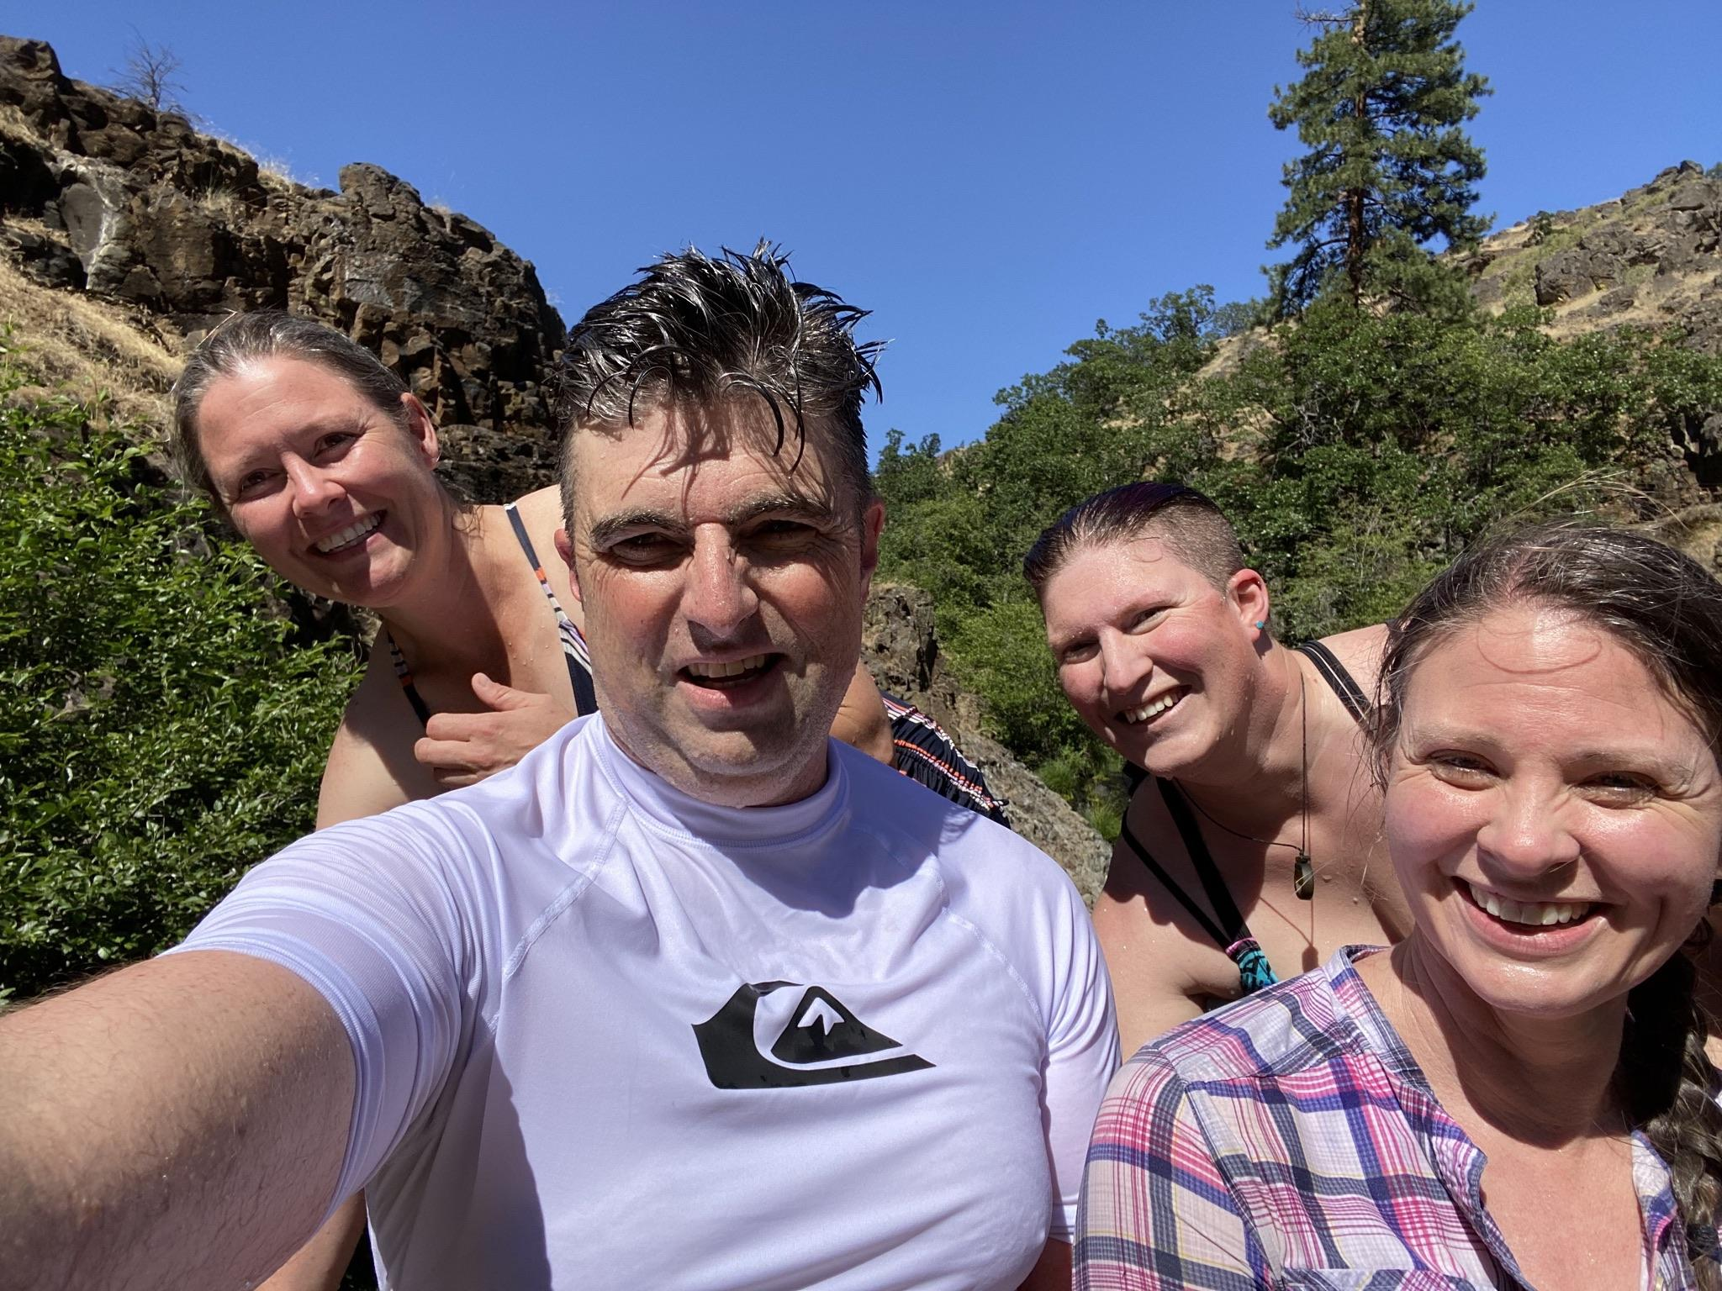
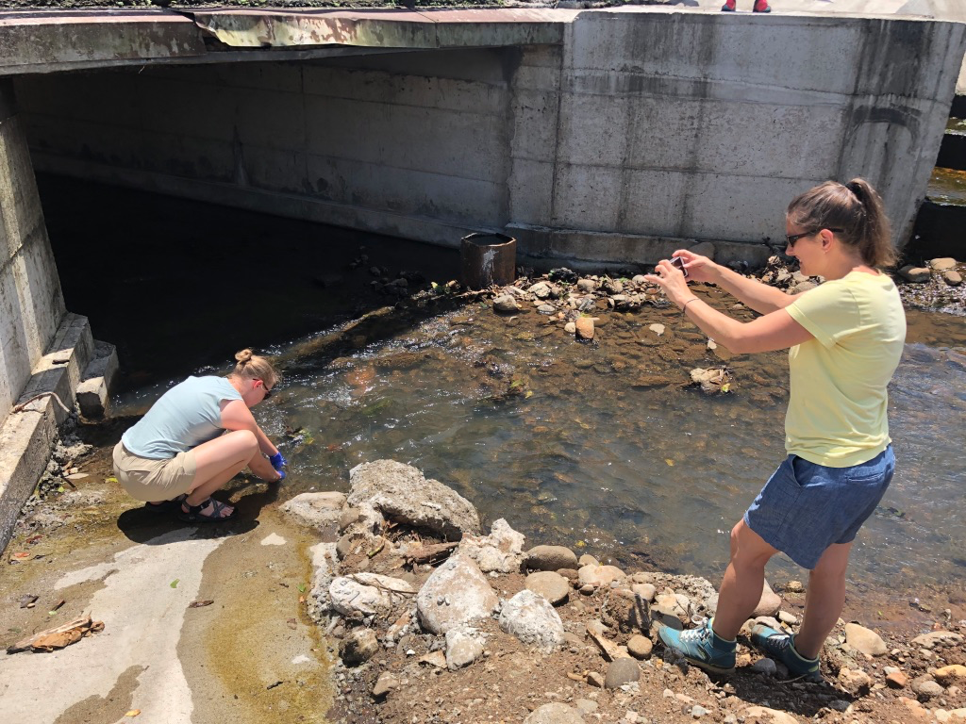
Faculty Team Members - 2022
Brianna Beechler, DVM, Ph.D.
Justin Sanders, Ph.D.
Michelle Steinauer, Ph.D.
Rhea Hanselmann, DVM, MPVM, Ph.D.

Slide 7

Student Team Members - 2022

Slide 8
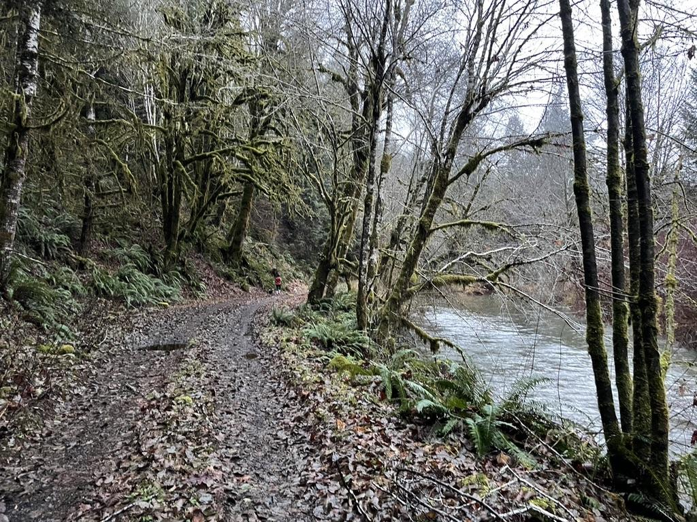
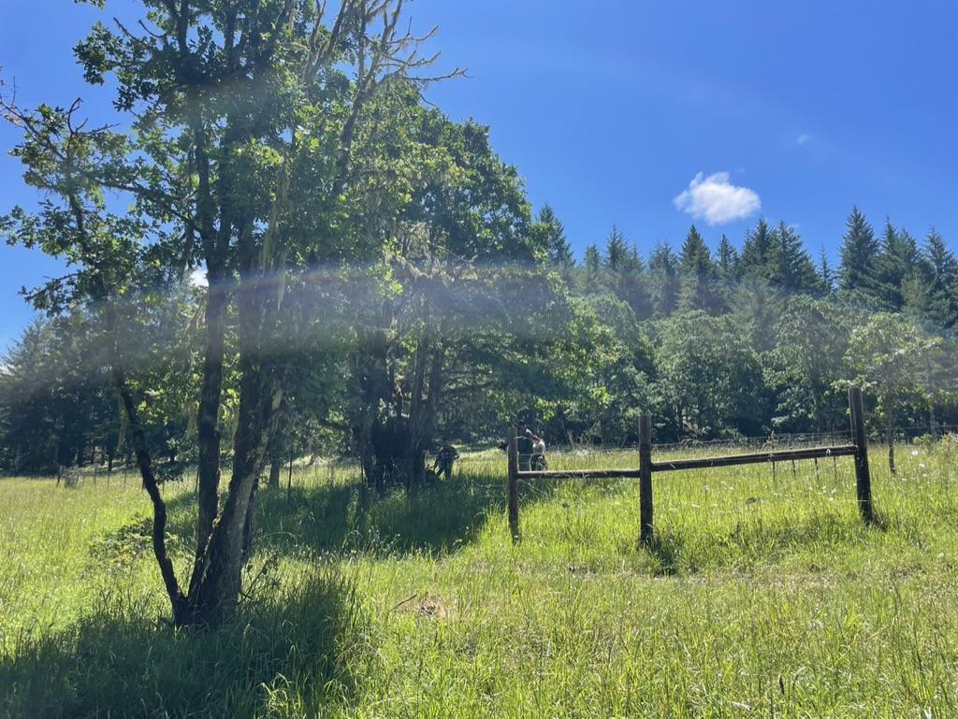
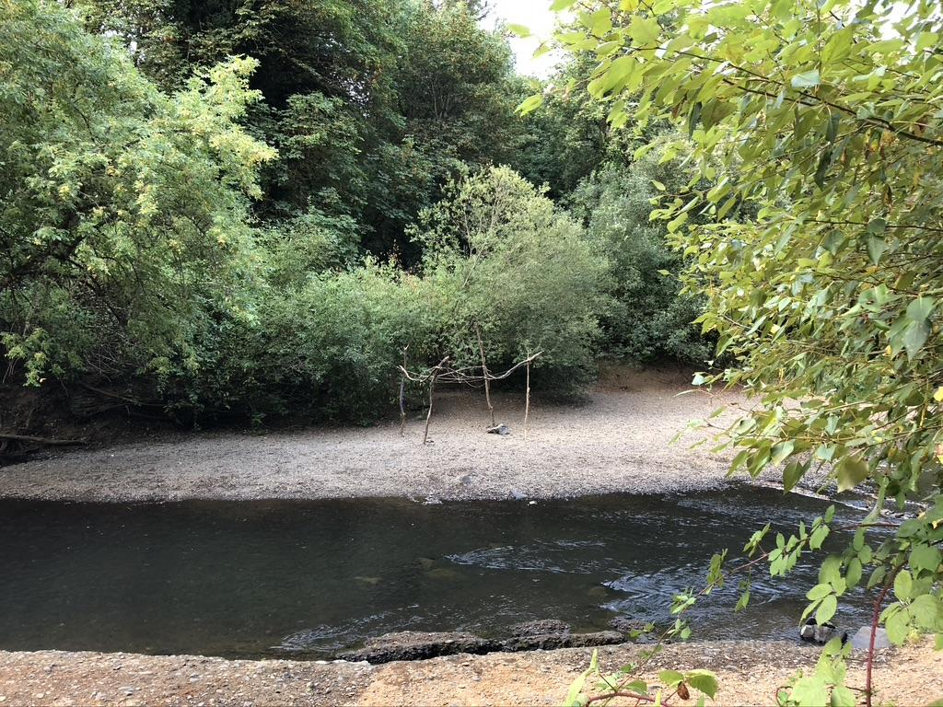
Research Objectives
Conduct preliminary surveys along two river systems to understand the prevalence of:
  antibiotic resistant E. coli
  zoonotic waterborne pathogens
  tick-borne pathogens
Determine whether antibiotic resistance and disease prevalence correlate to land use
  Land use gradient from forest, farm, to town

Slide 9

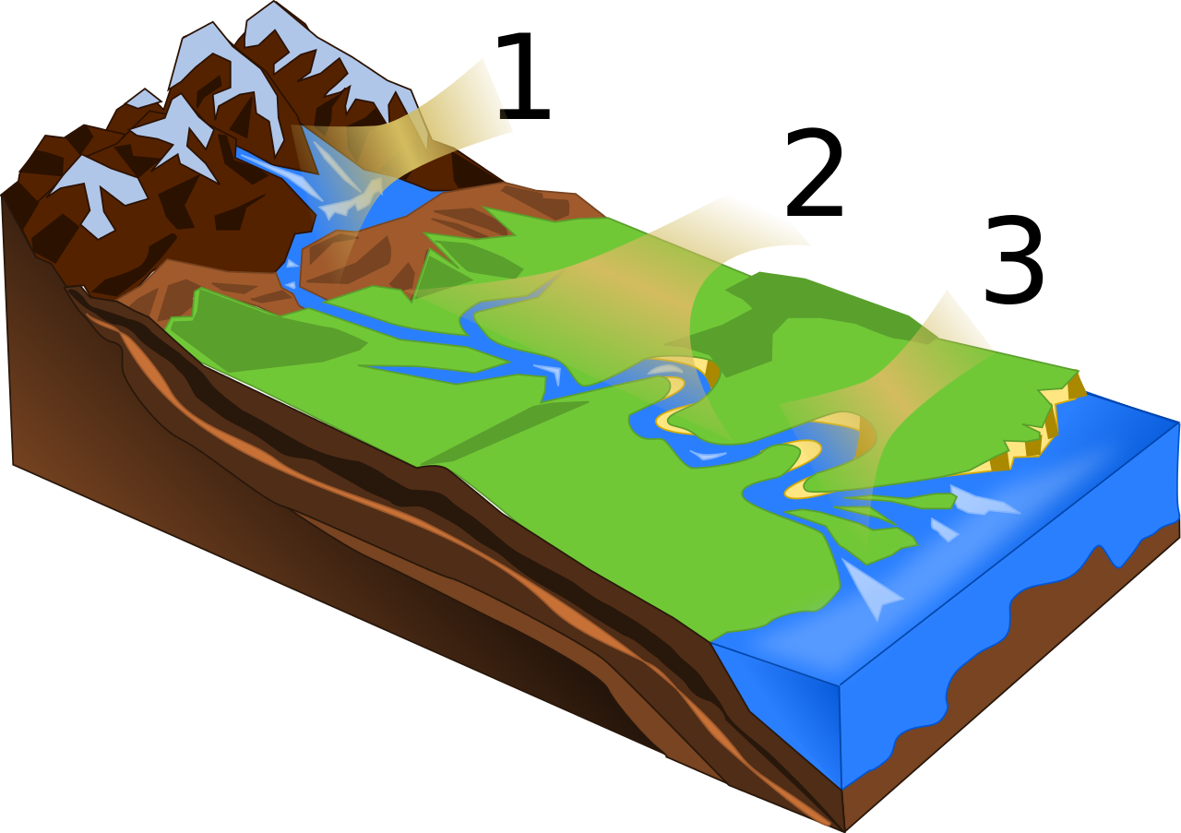


Project Methods: Sampling Locations
Criteria for sampling sites:
Land use gradient
  Least to most disturbed
  evenly(ish) distributed
Relevant habitat
  Water access
  Access to surrounding vegetation
Safe access
  permissions/permits
Notes:
Overview of project methods: 5 min
Kacy
Self Intro
Methods: Site locations & Sampling design
For the one-health project we wanted to select sampling site along a land use gradient from low to high disturbance, comparing one willamette valley watershed to one eastern oregon watershed.
For this project, We define Low disturbed sites as the sites with the least human traffic, and little to no residences. This means the headwaters, and adjacent forestry land.
Medium Disturbance is those with farms and livestock, and
Most distrubed locations are going to be defined as within city limits, and highest public use.

Slide 10
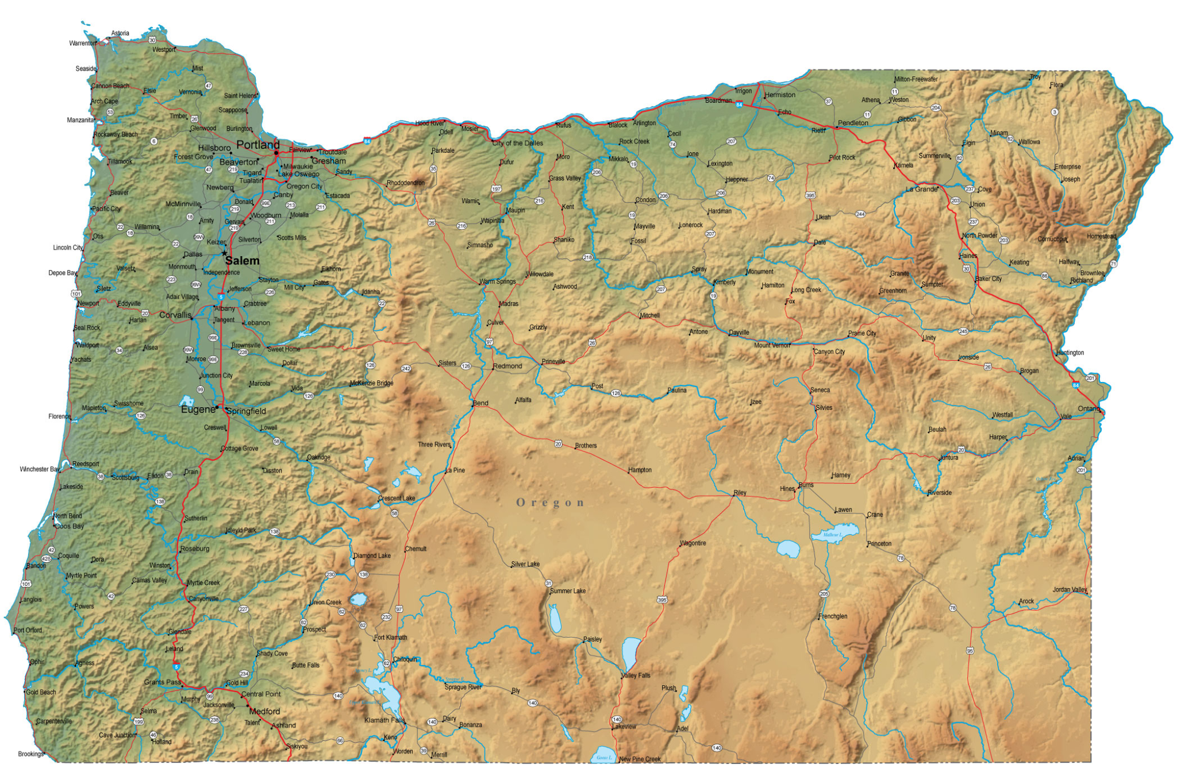
White River Watershed
Marys River Watershed
Notes:
Two watersheds were chosen: the Mary’s RIver watershed, in the willamette valley,
and the White river watershed, in the rain shadow of Mt Hood.
For the Marys RIver watershed, 40 candidate locations, spaced fairly evenly along the river, were chosen by myself and the Dr’s by aerial photo and google maps, and I went out to knock on doors and groundtruth.

Slide 11
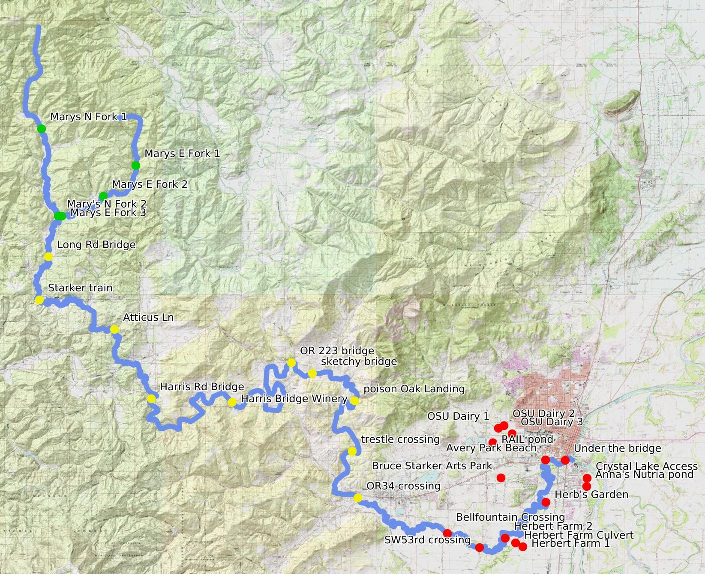
Marys River Watershed
Low disturbance
n=5
Medium Disturbance
n=10
High Disturbance
n=6
Ponds
n=7
Notes:
28 locations were finally picked after 2 weeks of knocking on doors and talking to city representatives for permission to access. Every site was hiked to and checked for safe access prior to the project’s start.
This is the Marys RIver watershed map with our final locations marked in Green, Yellow, and Red by disturbance level.
The majority of the sites were accessible via county roads, though a minority of landowners did gave us access for this project.
4/7 ponds were on OSU property, and were surveyed before the class started to prove the methods could be done with adequate safety.

Slide 12
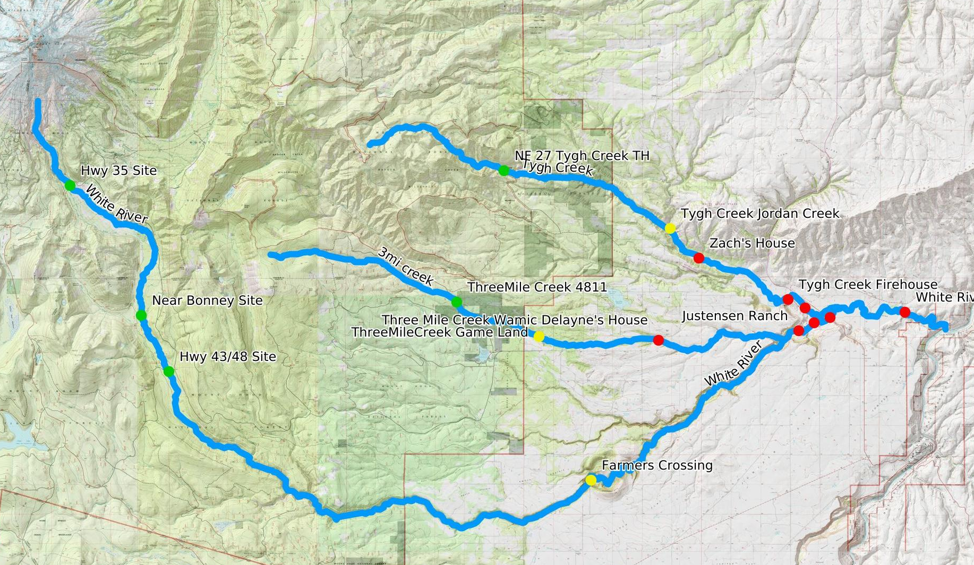


White River Watershed
Low disturbance
n=5
Medium Disturbance
n=3
High Disturbance
n=8
White River Fire 2020
Notes:
The White River Watershed had an additional level of complication: this river is designated a National Wild and Scenic river. Federal Scenic river designations limit the accessibility of the water itself, and
some areas were closed to access due to fires in previous years-
so for practical reasons, Dr Beechler Included two tributaries of the White River: 3 Mile Creek and Tygh Creek. For reference, this watershed drains into the deschutes river.
Again the sites are labeled her from high to low in green, yellow, and red.

Slide 13
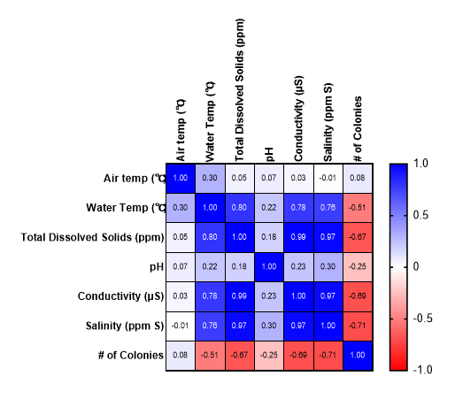
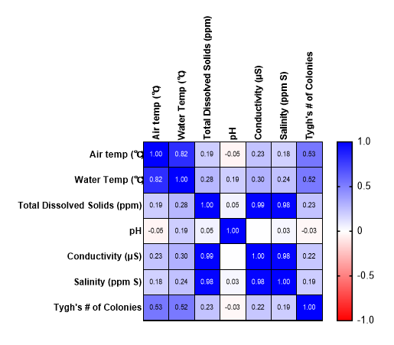
Water Quality Correlations
Mary’s River
White River
White # of colonies
White
Notes:
Brief Water Quality Talk ~3-5 min
Bryce
TDS = Dissolved inorganic and organic material in water sample
Salinity = dissolved salts in water sample
Conductivity = The ability of an electrical current or heat to move in water sample

Slide 14
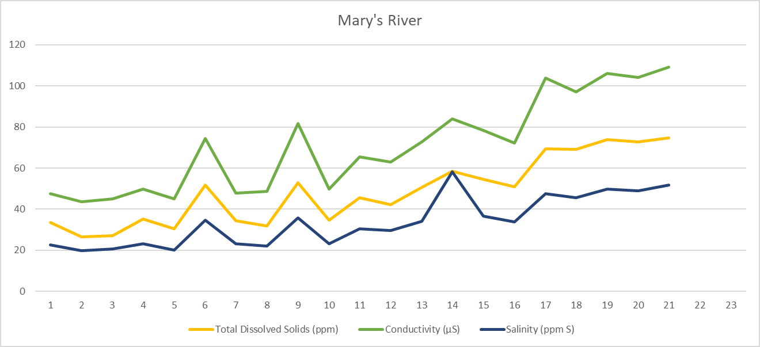
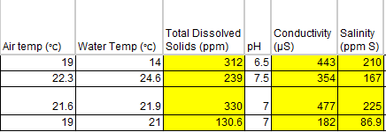
Mary’s River vs Disturbance Level
Change to total dissolved solids, salinity, and conductivity as disturbance level became greater.
No significant change to pH (6.5 and 7.0).
No change to water or air temperature as disturbance level grew.
4 locations removed due to stagnant water.
Notes:
Brief Water Quality Talk ~3-5 min
Bryce

Slide 15
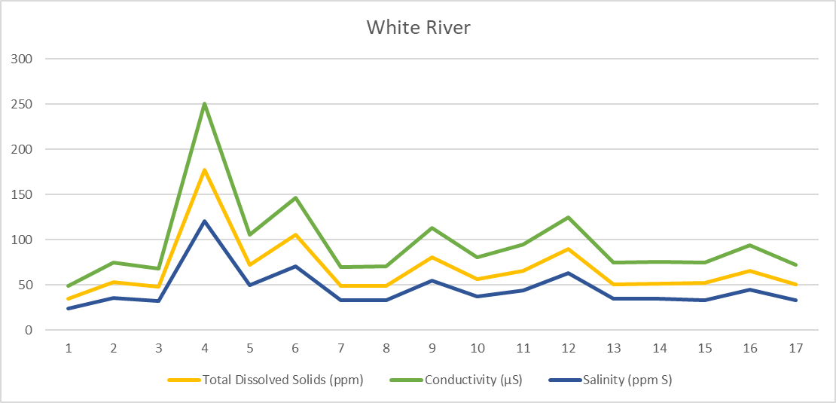
White River vs. Disturbance Level
No noticeable differences to total dissolved solids, salinity, and conductivity as disturbance level became greater.
pH stayed between 6-7.0 with one location at 7.5

Slide 16
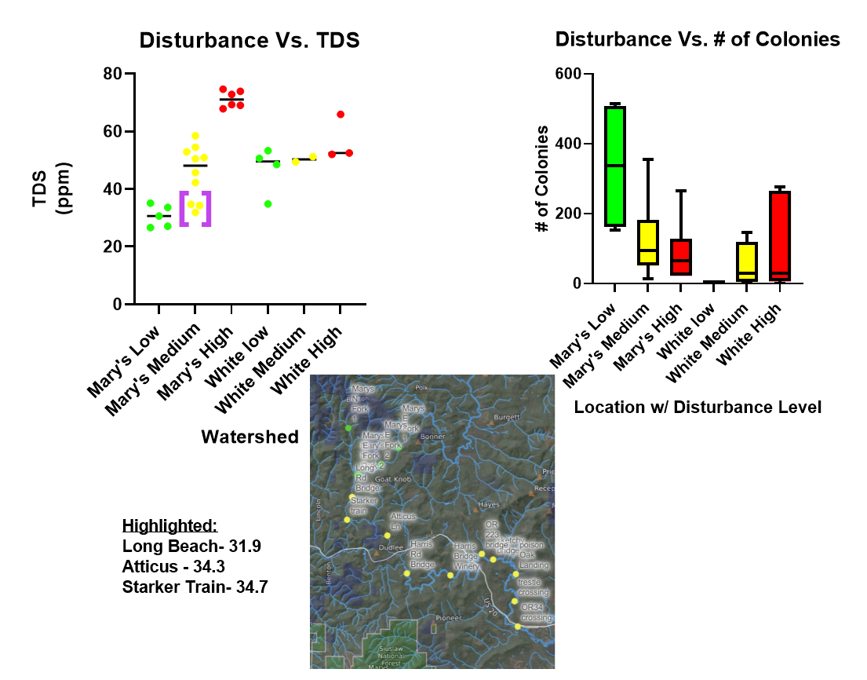
Disturbance vs. TDS for Mary’s and White River.
Bracketed colonies are the 3 closest moderate disturbance sites to low disturbance sites.
# of E. coli colonies lowered as disturbance level increased at Mary’s river
# of E. coli colonies did not change as disturbance level increased at White river
Moderate negative correlation between disturbance level and # of E. coli colonies at Marys.
Notes:
ANOVA
Mary’s sig. DvS = yes
White sig. DvS = no
Mary’s sig. Dv# = yes, not strong.
White sig. Dv# = no

Slide 17
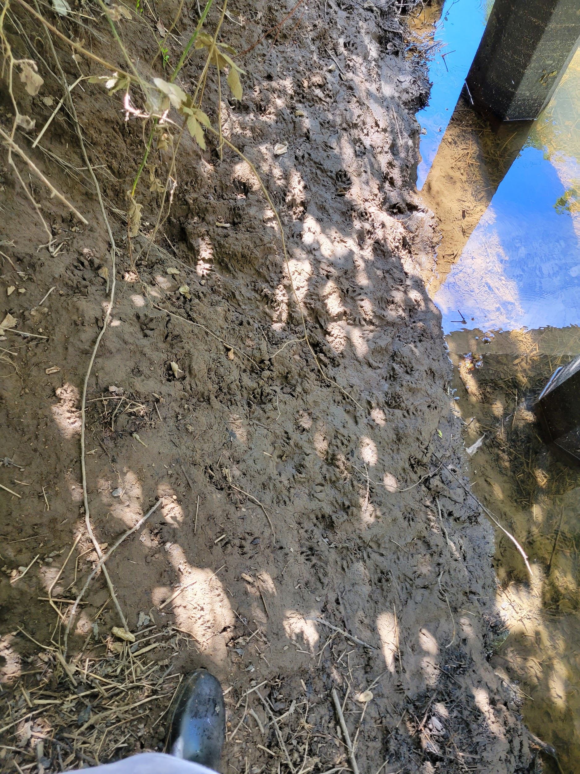
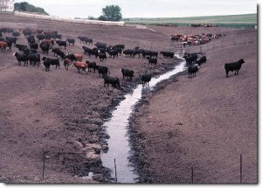
Antibiotic Resistance
Intro- One Health perspective
E. coli is a coliform bacteria that lives in the lower intestinal tract of warm-blooded animals.
  E. coli found in water is typically due to fecal runoff.
Antibiotics used in human and animal populations enter the ecosystem via this route.
Repeated exposure to antibiotics leads to resistance.
Notes:
AMR: 5 min
Holden
Hello, I am Holden, one of the undergrads that worked on this year’s One Health Project. To start here, I’ll jump in with defining how E COLI achieves this projects goals.
E coli can be found in the water due to interactions with host animals. This gives information on the land use of that area—-Lots of agricultural use and human sewage draining could lead to high levels of waterborne e coli. Antibiotics used in these populations can also enter the water via this run off and expose the ecosystem to these antibiotics. Human medicine has an overprescription problem when it comes to antibiotics and Agriculture uses antibiotics frequently on livestock as well. This inquiry was designed to show which antibiotics were most often found to have resistance
Why e coli -> logistically simple, easy to grow, prolific, good model for gene flow

Slide 18
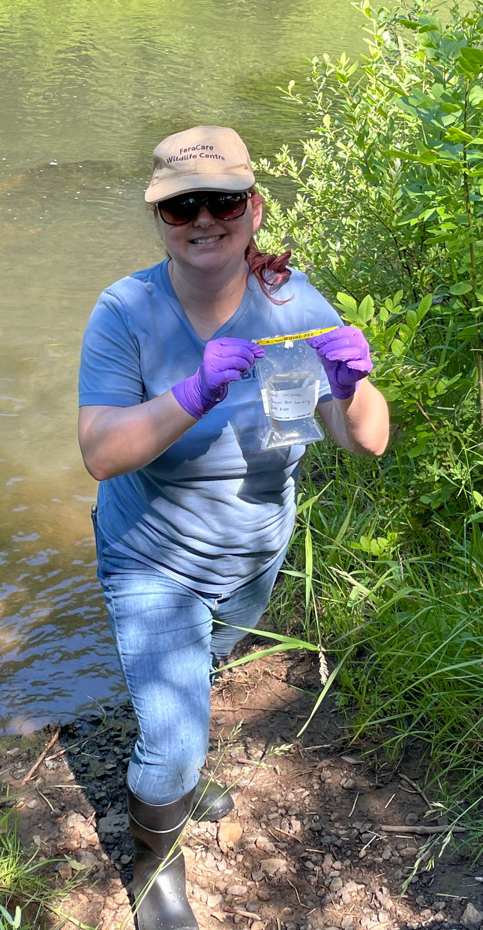
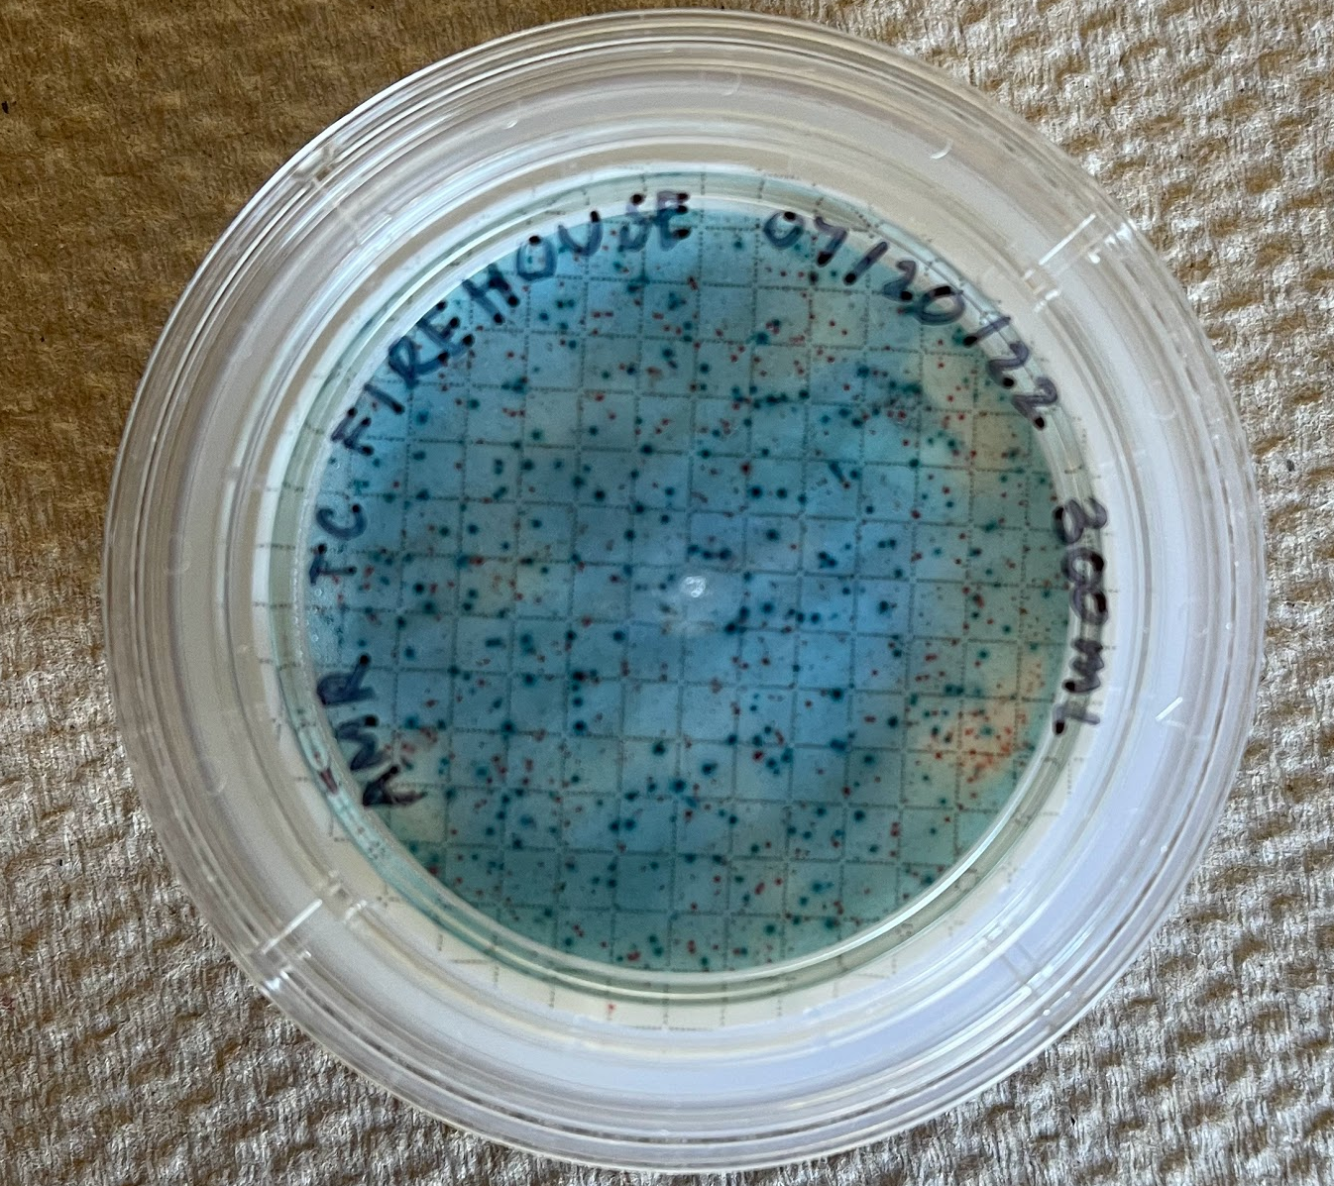
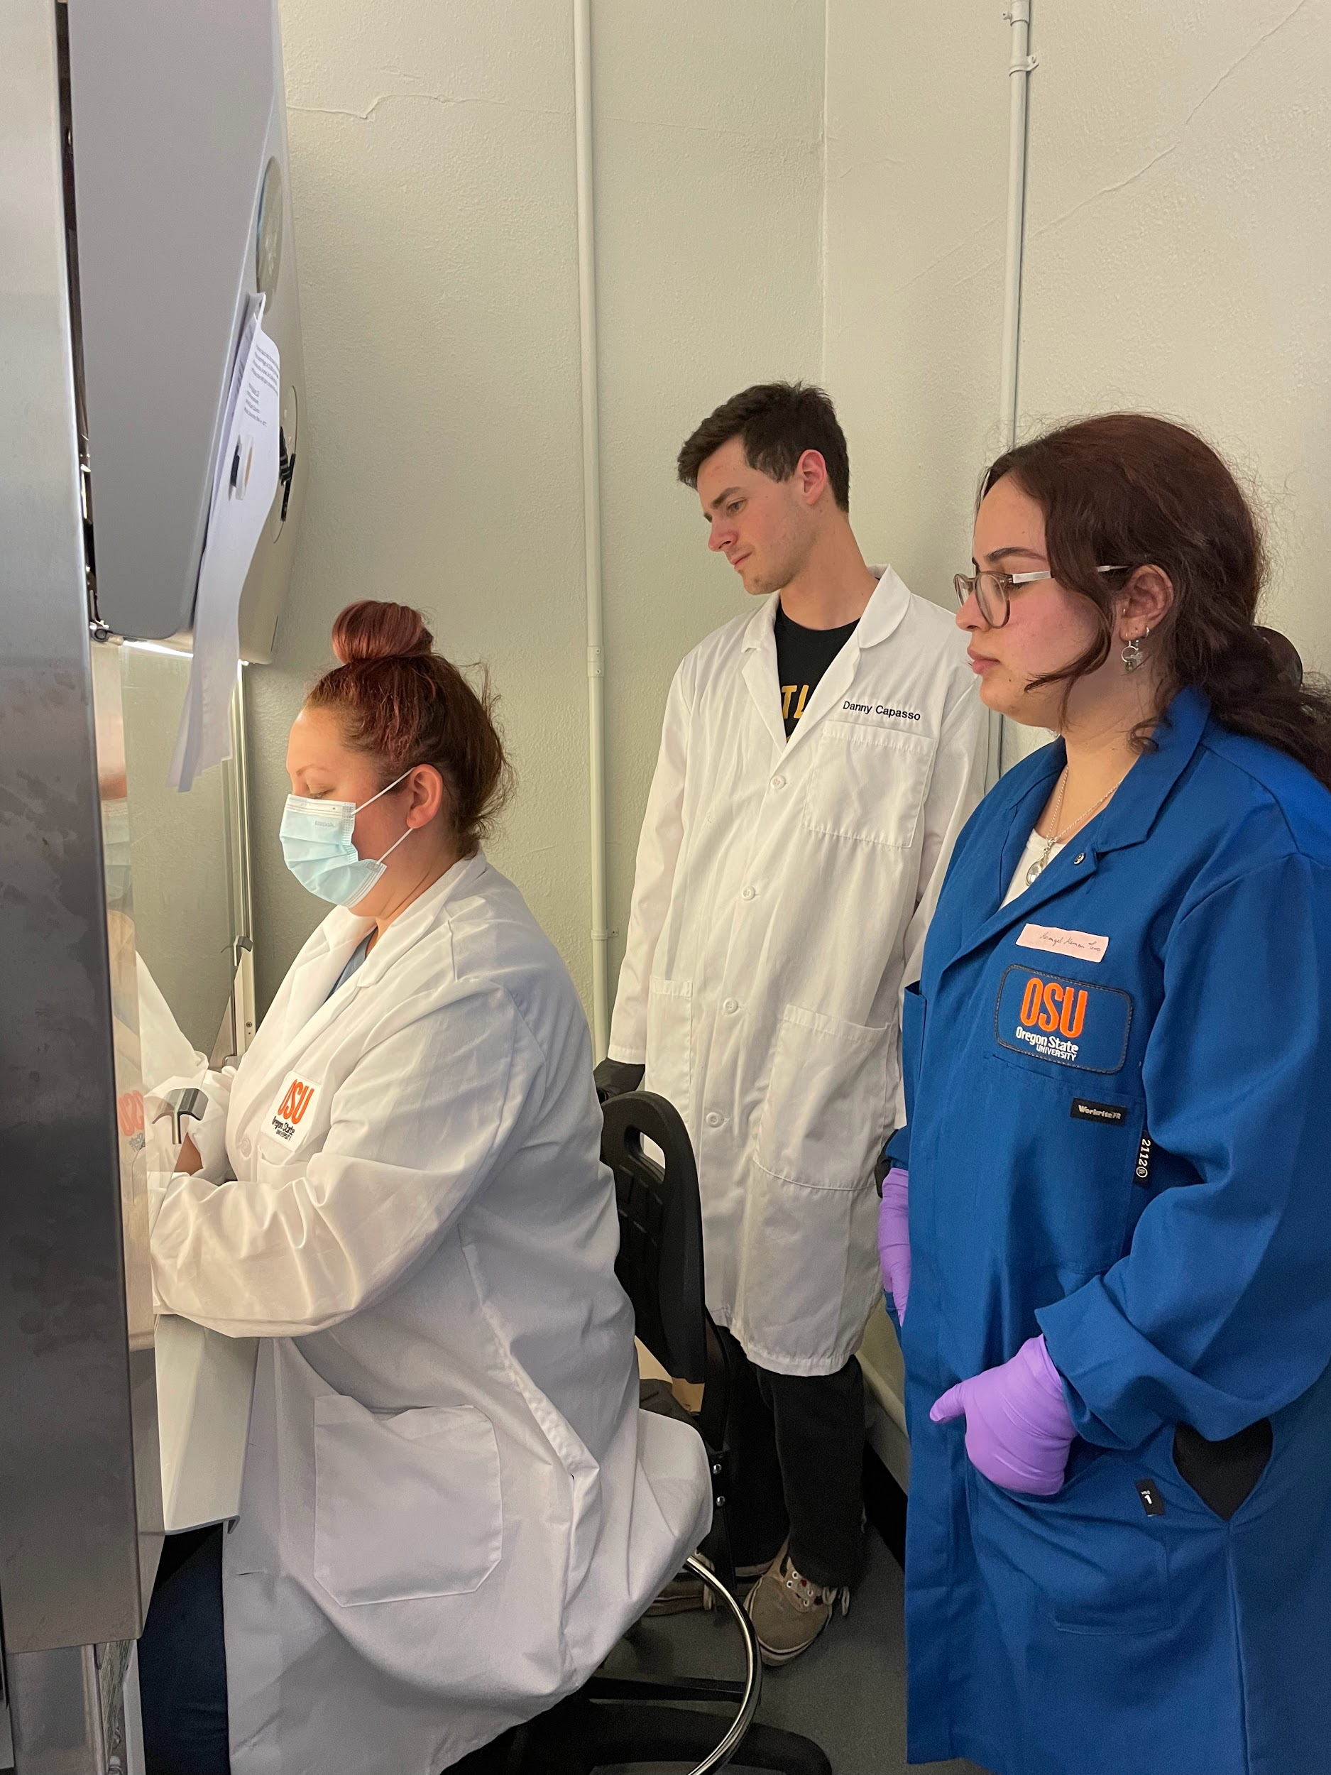
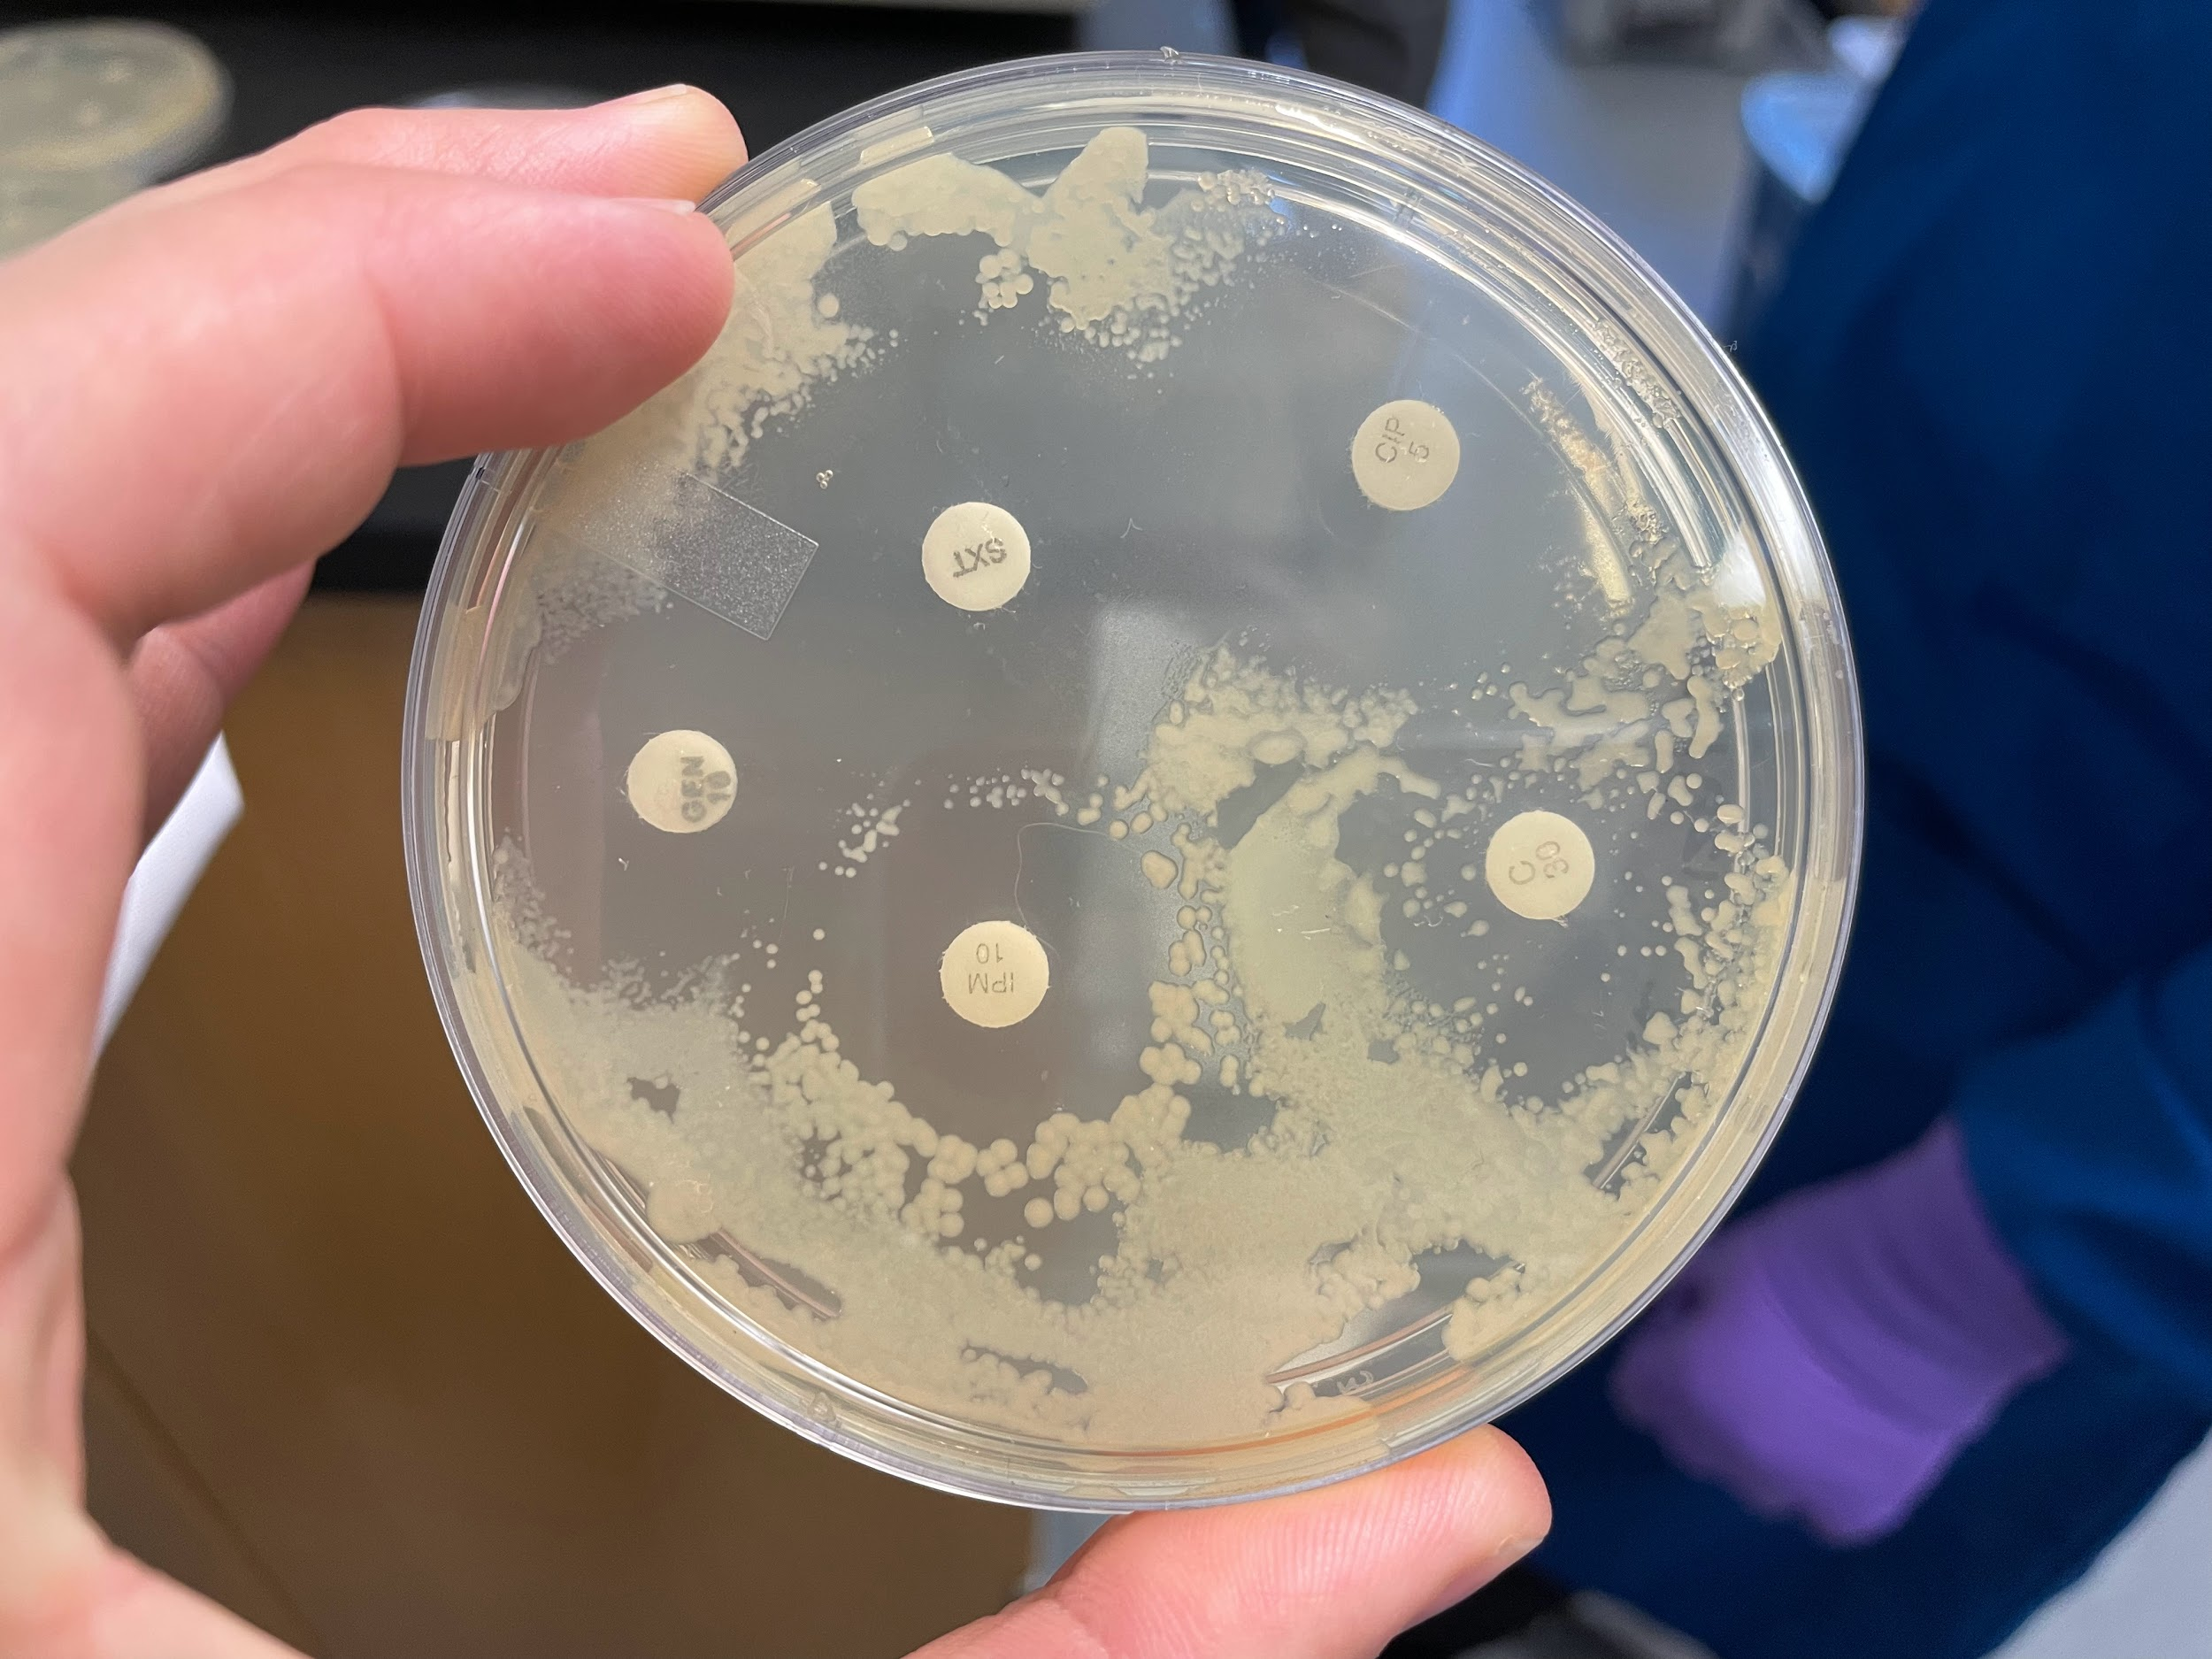
Antibiotic Resistance
Notes:
Here we have our different stages of the project. On the right Out in the field we collected water samples in sterile, single use whirlpaks, These samples were filtered in a biosafety cabinet onto an M. COLI blue plate that marked E. COLI colonies. These colonies were collected with a BBL prompt inoculation system and plated onto agar plates where antibiotic disks were overlaid.
Each site was tested with Ampicillin, cephalothin, chloramphenicol, tetracycline, kanamycin, imipenem, ciprofloxacin and (SULFA METHOX A zole) Sulfamethoxazole Trimethoprim (SXT) After 12 hours at 37 celsius the plates were measured for zone of inhibition or ZOI. (the area cleared of bacteria surrounding the antibiotic disk) Each antibiotic has a specified ZOI under which the bacteria is clinically resistant. This was the value we also used to signify resistance.

Slide 19
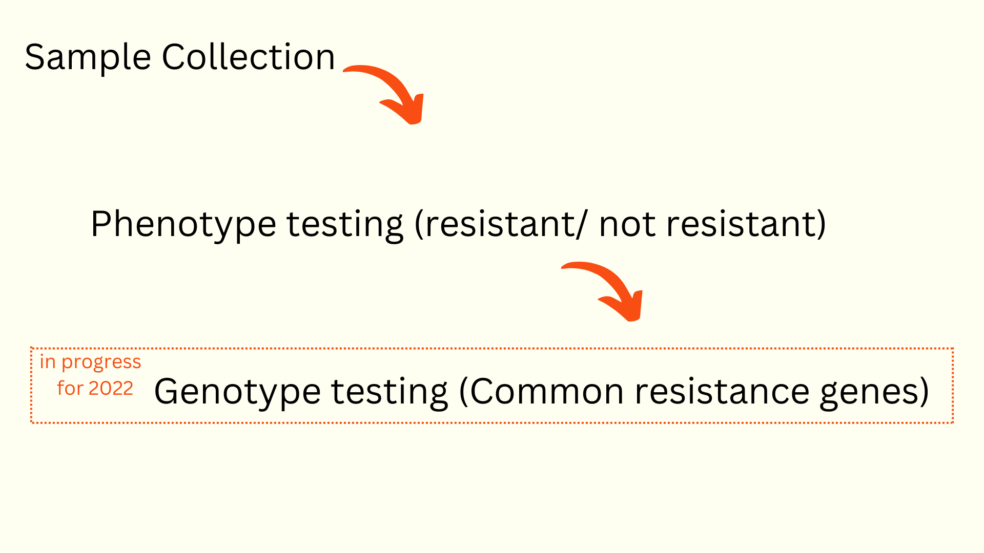
Notes:
This is a higher level project overview. We collected field samples of 2 Oregon Watersheds, The Mary’s river watershed near corvallis and the White river watershed in Tygh Valley. E COLI from these samples were isolated and grown to test levels of antibiotic resistance. This was all done over the summer, with each site’s resistance phenotype being processed within 2 days of sample collection. The next stage of the project began once all samples were collected. This is the DNA analysis of the resistant E COLI. DNA extraction began at the beginning of August and has just finished. The results of this DNA analysis will show DNA variance between resistant E COLI, This is needed data to see how resistance genes are moving or not moving in the environment.

Slide 20
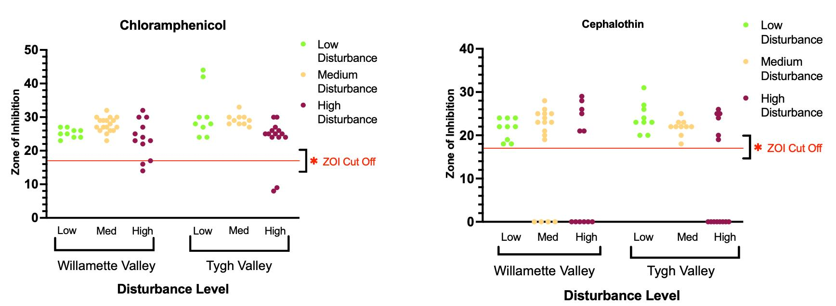
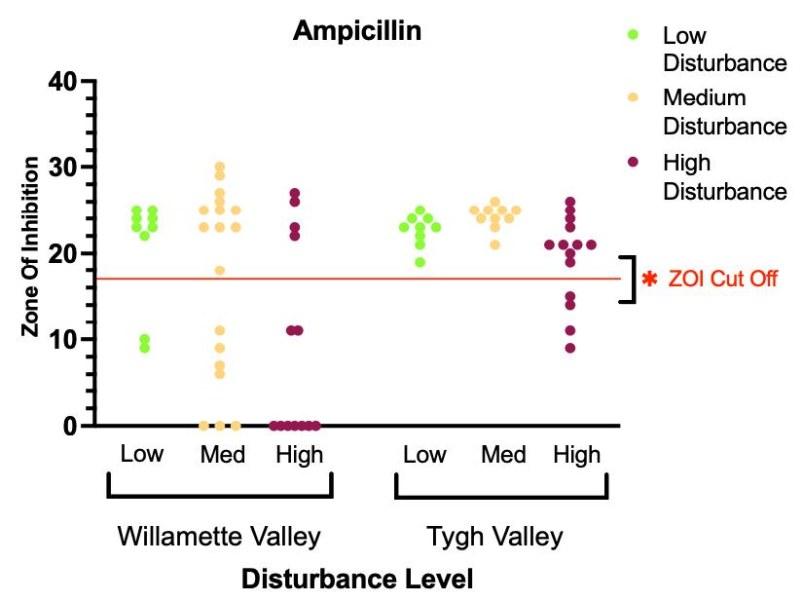
Mary’s River
White River
Mary’s River
White River
Mary’s River
White River
Notes:
AMR: 5 min
Holden
Of the 8 ABx we tested 5 had resistances found. Tetracycline, Kanamycin, Ampicillin, Chloramphenicol and Cephalothin. The red cut off line is each antibiotics ZOI cut off where points below that line are resistant and points above still susceptible. The main pattern the data shows is the increase in resistance in the high disturbance sites, especially in the Mary’s RIver. Another trend worth looking at is which antibiotics have large variation near the ZOI cut off. Observe the difference between Ampicillin (large variation) vs cephalothin (tighter grouping). As mentioned previously, our ZOI cutoff value is the value at which a bacteria is said to be clinically resistant— however, these large variations at or near the cut off are not as binary and could show intermediate forms of resistance. With ampicillin in particular this is likely to be true because E COLI can have natural resistance to ampicillin, which is why our study is rounded out with a genetic analysis to examine these patterns from a genetic point of view.
E coli can have intrinsic resistance to ampicillin — why genotypes and acquired patterns are important

Slide 21
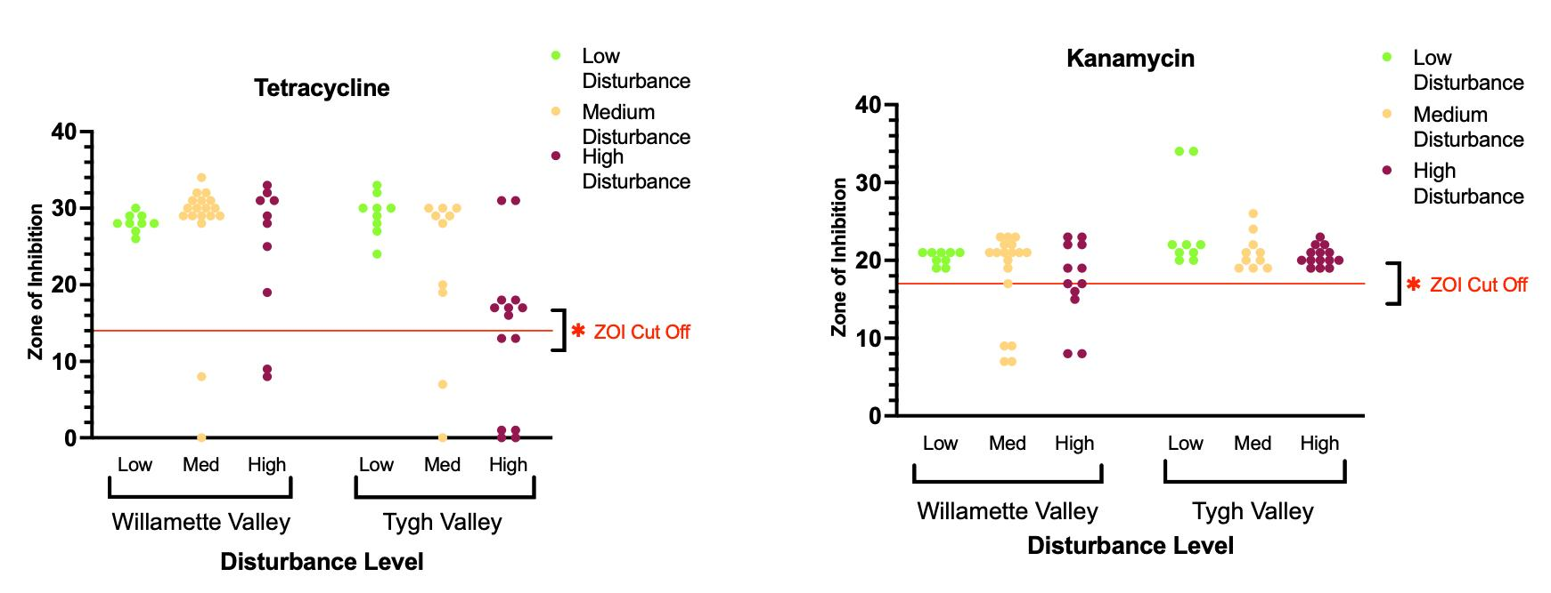
Mary’s River
White River
Mary’s River
White River
Notes:
Here are our last 2 antibiotics to have resistance, interestingly, Kanamycin had no resistances in the Tygh Valley.

Slide 22
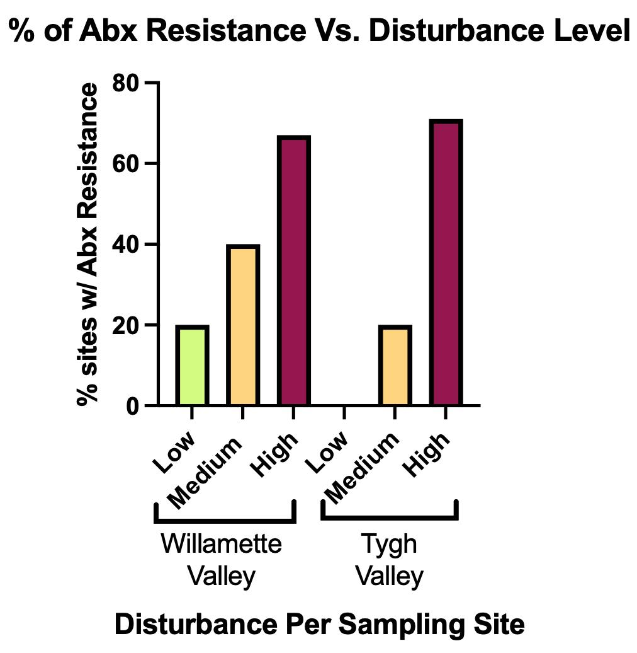
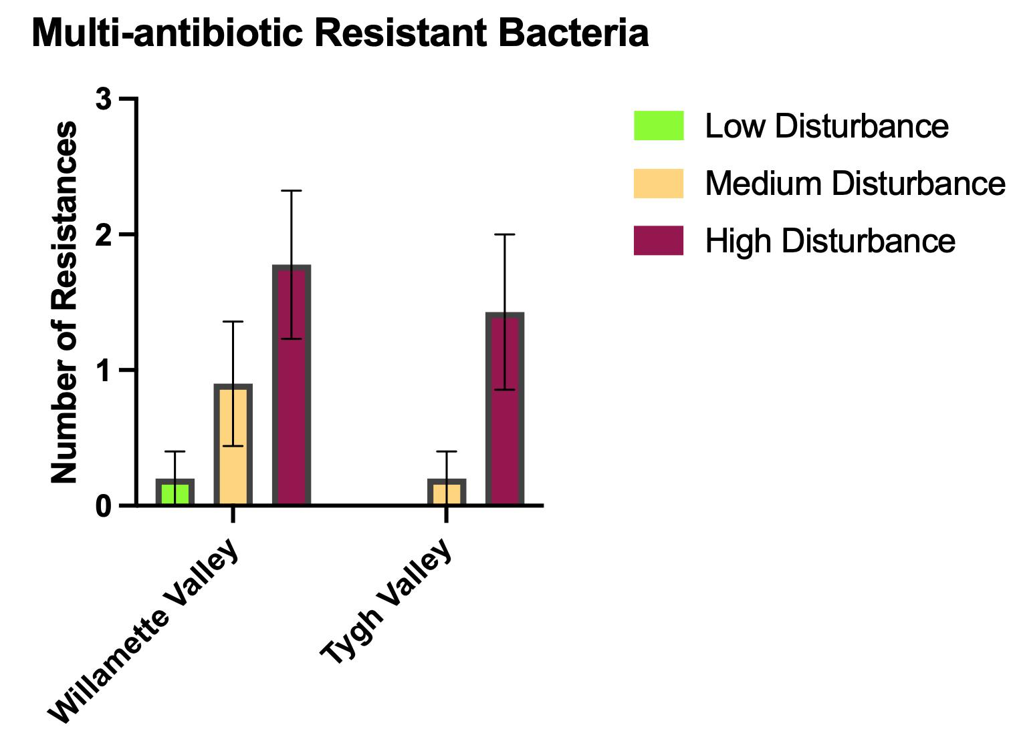
Antibiotic Resistance
Mary’s River
White River
Mary’s River
White River
Notes:
Moving on to some summary graphs, on the left we can see the percent of sites with resistance to one antibiotic, this fits the pattern shown in the previous slides that high disturbance sites have more antibiotic resistance. ====
Mary’s river watershed = 67% rate of resistance in highly disturbed sites
White River watershed= 71% rate of resistance in highly disturbed sites
On the right we have the average number of resistances within a site, This shows the average Mary’s River high disturbance site had almost 2 resistances while the average low disturbance site had close to 0.

Slide 23
Antibiotic Resistance
Learned
With more disturbed land use, the associated watershed had higher levels of antibiotic resistance.
Continuing items
Genomic sequencing to identify markers of antibiotic resistance in E. coli
Multi-year phenotypic changes
Resistance pattern vs land use fecal sampling
Notes:
AMR: 5 min
Holden
FOund: Higher levels in both number of antibiotics E coli were resistant to and rate of finding resistance in a specific ABx when increasing disturbance level
Currently, the data supports both high land use equalling high resistance and resistance accumulating as sampling moves downstream.
Hence why the project will continue with genetic analysis of this summer’s samples as well as collection of future samples to continue to observe the resistance pattern on a phenotypic and genomic level.
The future aim of this project is to connect these resistance patterns with the land use and any changes in land use by sampling host feces as well.

Slide 24
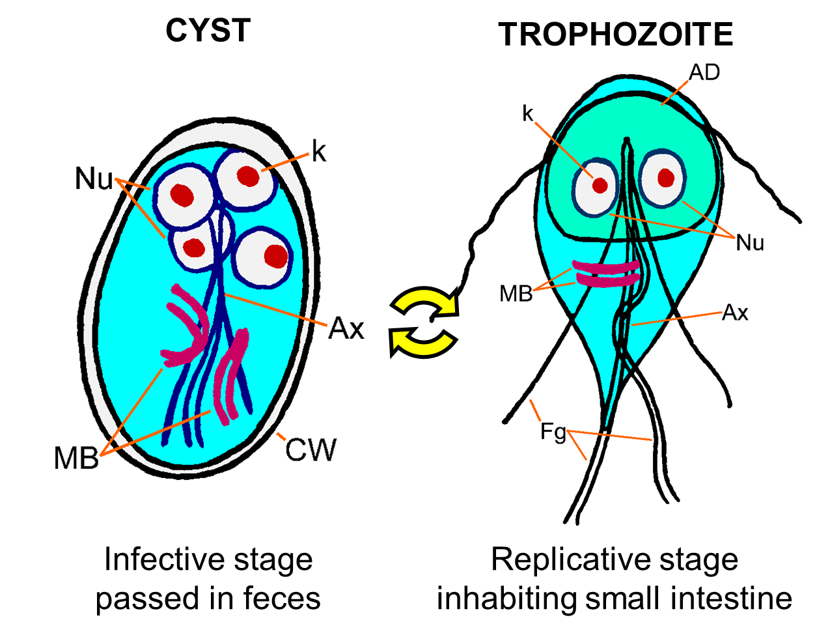
Waterborne Pathogens: Giardia
Giardia is a zoonotic protozoa that infects the GI tract
Transmission
  Fecal-oral
  Direct or indirect
Notes:
Lepto & Giardia, Project “optimization” 3-5 min
Danny
Dzs were chosen because they are the primary dzs in the PNW tat we
Giardia can be spread through direct contact with feces or indirectly through surface water
Worldwide distribution
There is some zoonotic potential of assemblages C-H
Assemblages A and B are zoonotic, have many subassemblages
4N- has intragenomic heterogeneity

Slide 25
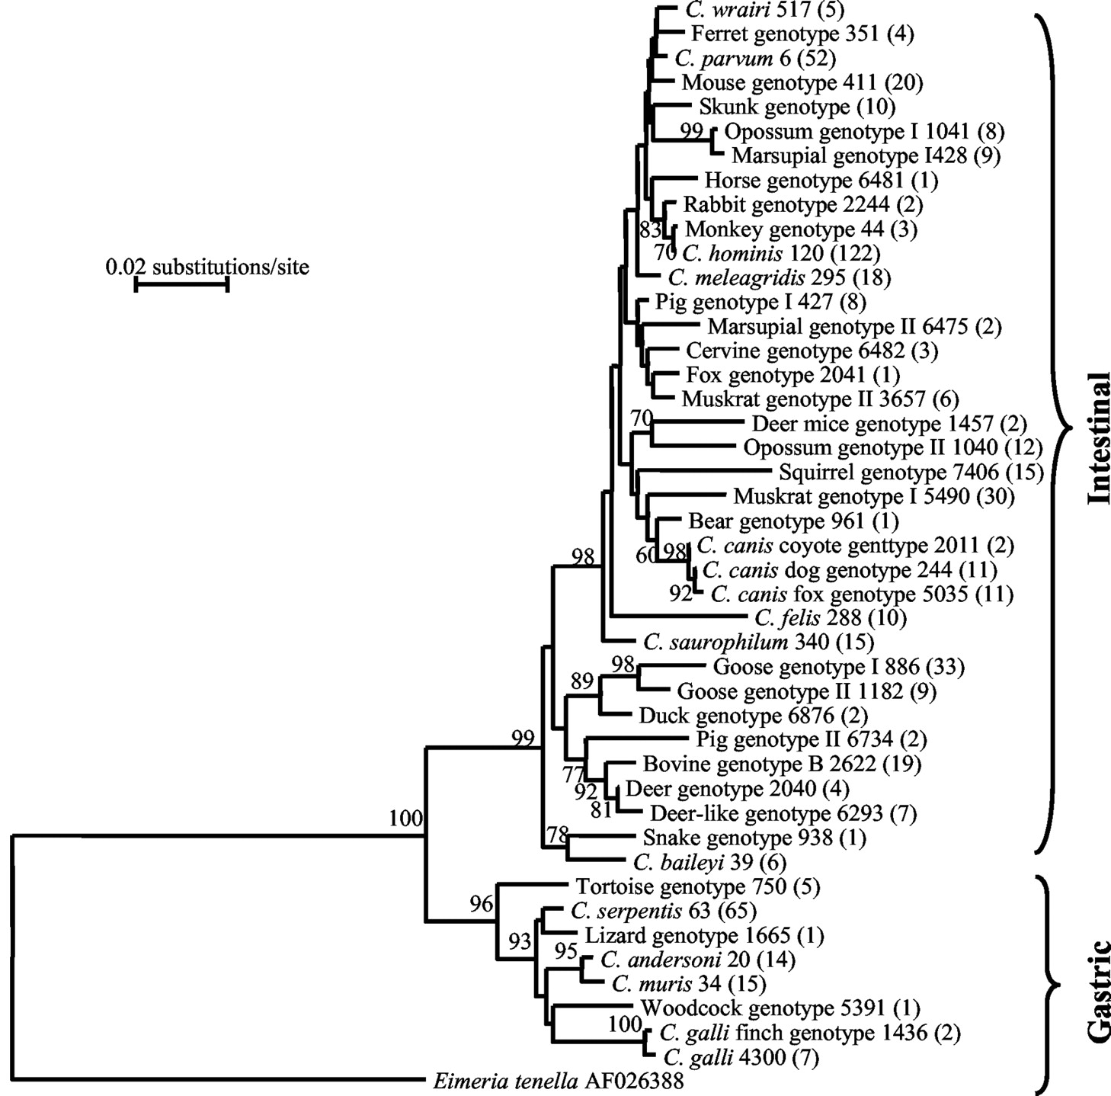
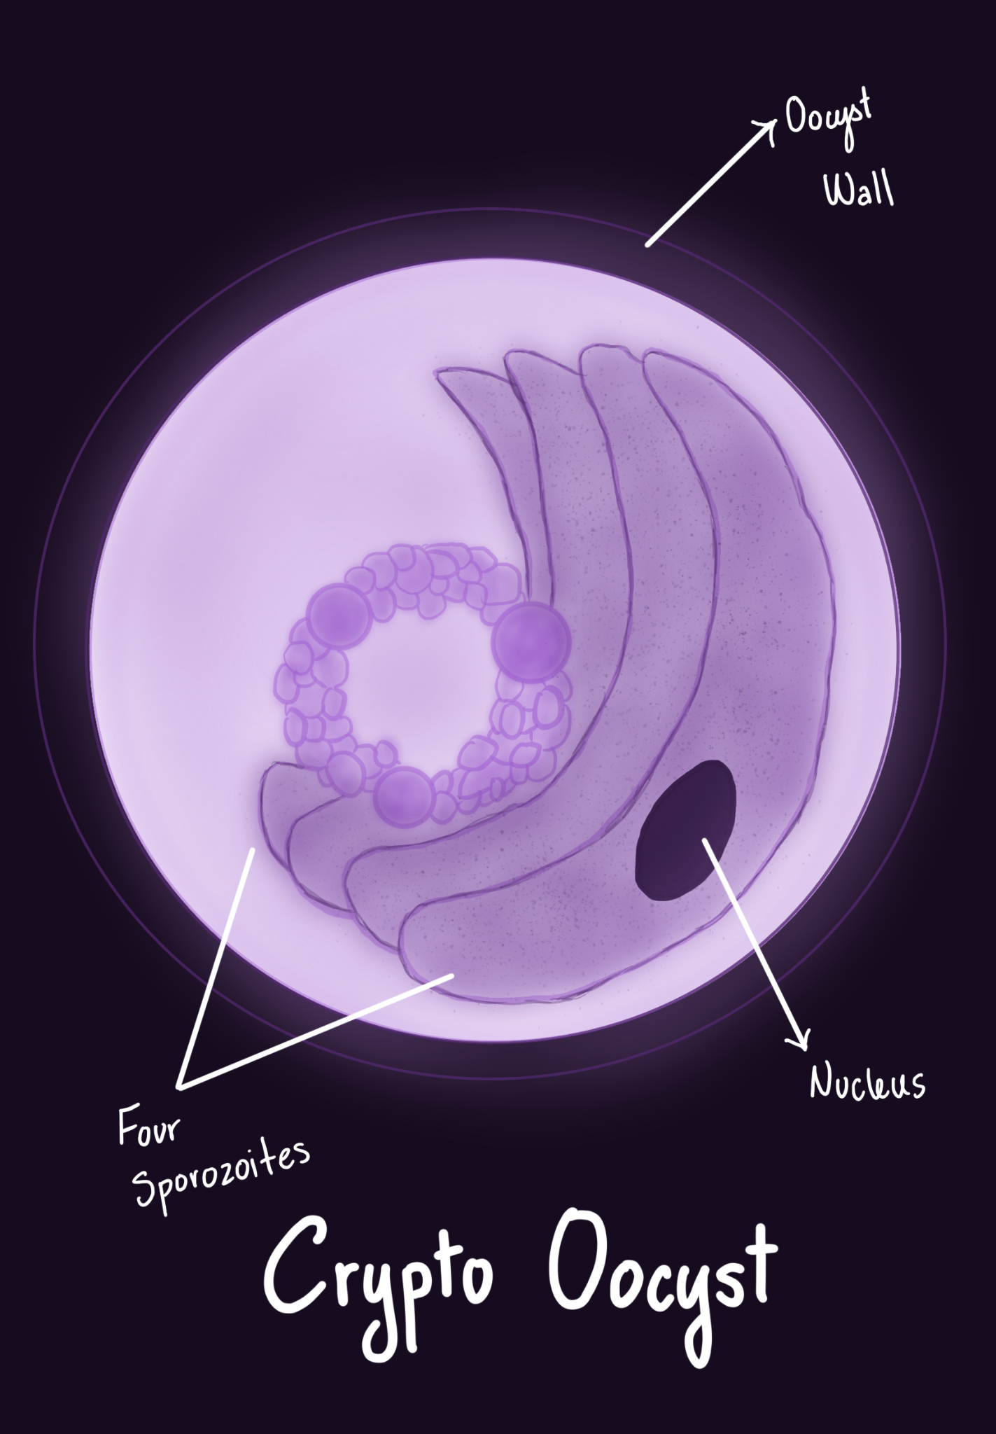
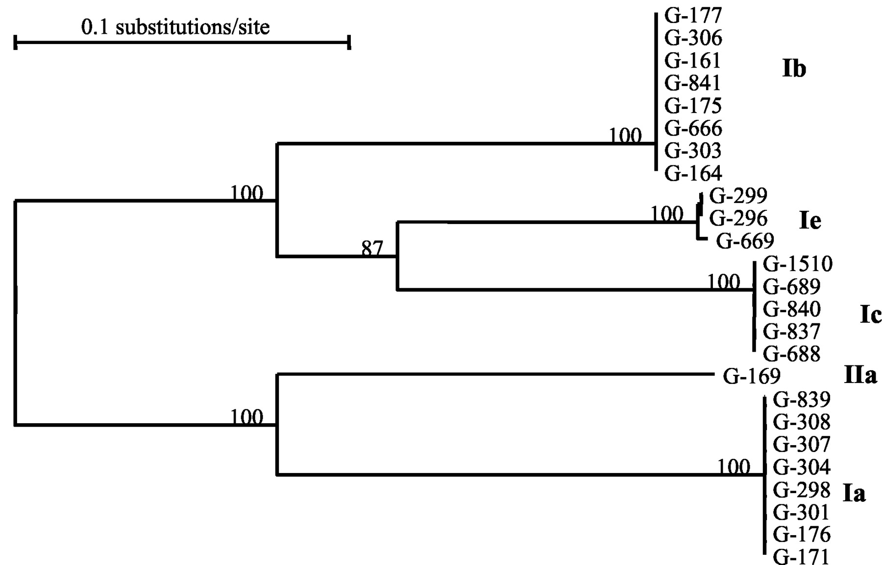
Waterborne Pathogens: Cryptosporidium
Subtype families: For C. parvum, IIa, IIb, IIc, etc., and for C. hominis Ia, Ib, Ic, etc.
Notes:
Mariangel (Don’t forget to cite images)(Change phylogenetic tree/ make your own phylogenetic tree)
Hi, my name is Mariangel, I am an undergraduate student majoring in Biology and I will be talking to you about Cryptosporidium today.
Similarly to Giardia, Cryptosporidium is another zoonotic protozoan parasite that infects the GI tract.
They are found worldwide, but most commonly in ambient surface water.
Crypto is distributed through all mammalian, avian, and reptilian species.
The main route of transmission is through direct and indirect contact as well as fecal to oral routes.
These species may vary depending on geographic location and the hosts’ developmental stage.
Infective species also vary in animals, and most are host specific. The location and developmental stages in animals have been shown to be a determining factor in which type of Crypto species are infectious.
Cryptosporidium species vary at the genotype and subtype level. This means that there are different genotypes within a species and different subtype families within a genotype.
Humans and animals can share subtypes within specific genotypes which is a potential risk for zoonotic transmission and zoonotic transmission also varies among geographic areas.
THE OOCYST IS THE INFECTIVE STAGE AND WHEN INGESTED BY THE HOST IT CAN CAUSE DISEASE. THE HOST SHEDS OOCYSTS IN THE FECES WHICH ARE EXCRETED INTO THE ENVIRONMENT READY FOR TRANSMISSION.

Slide 26
Waterborne Pathogens: Cryptosporidium and Giardia
Objective of Study: Does Giardia and Crypto presence and species abundance change over a land-use gradient from low to high disturbance?
Expect to see higher strain diversity at low disturbance sites.
Will determine what populations of people and animals are at risk in Oregon.
Notes:
Crypto:3ish minutes
Mariangel
For this project we are exploring the distribution of Giardia and Crypto to see whether their presence and species abundance changes over a land-use gradient from low to high disturbance.
We hypothesize that we will find higher strain diversity at low disturbance sites because the high disturbance sites may allow strains that predominantly infect humans to outcompete the other strains. This will help us determine what populations of animals and people are at risk in Oregon by knowing which strains are in higher abundance where human activity is prominent.

Slide 27
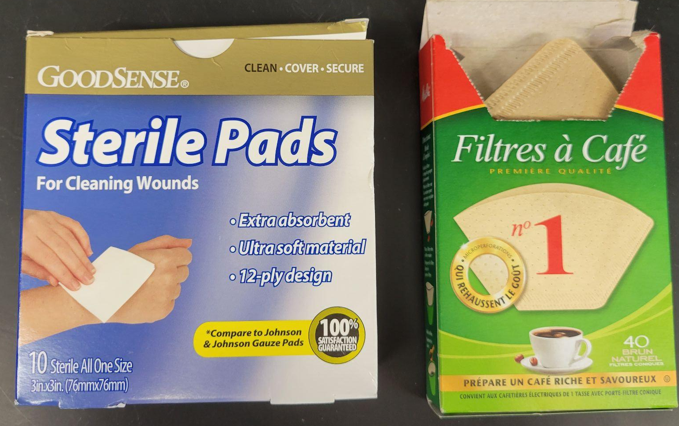
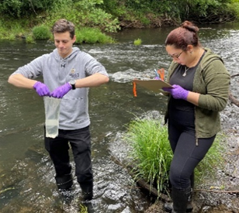
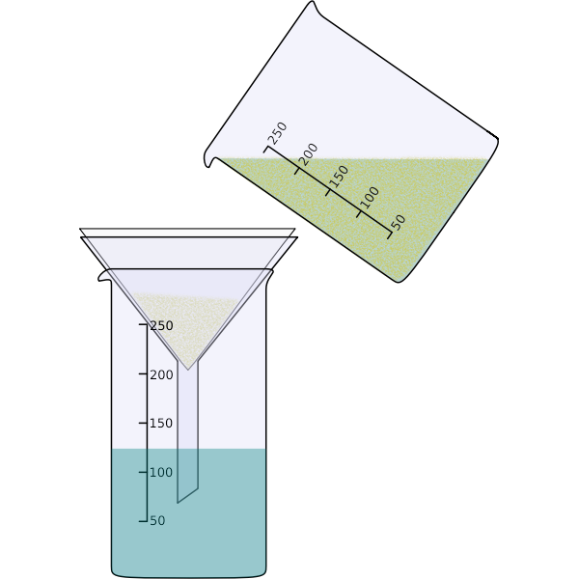
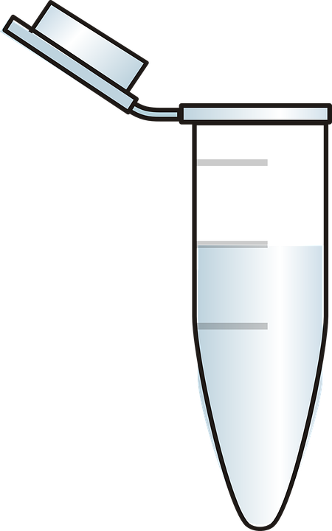
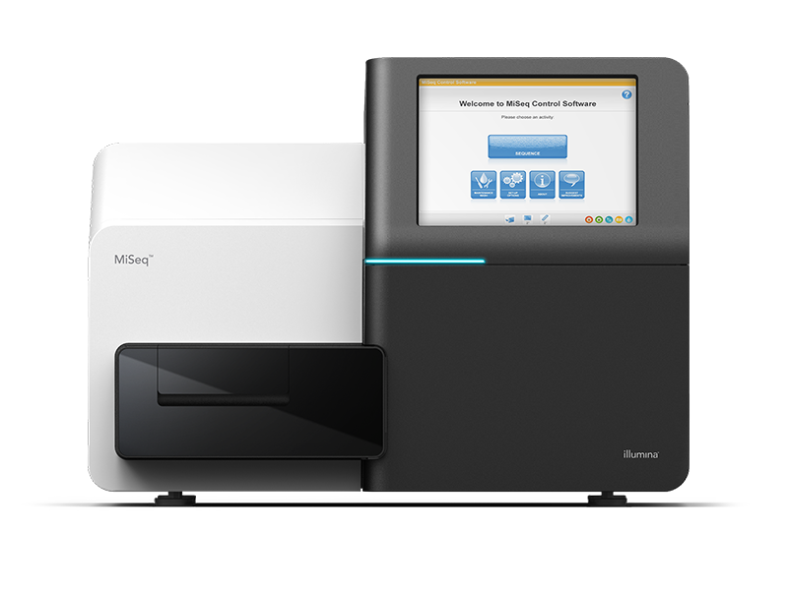


Waterborne Pathogens: Methods
Notes:
Danny
Quick, visual flowchart and verbal explanation of methods to make following slides more clear
Collect samples. We filtered first by using prefilters, which were gauze if the water was especially mucky and coffe filters, then we vacuum filtrated the sample through a 0.45 micron nitrate cellulose filter. After filtering, we collected the material in the filter for use in an Meridian bioscience’s merifluor immunoassay, which was used to detect giardia cysts and crypto oocysts. The raiming material was used to extract DNA for PCR. Us

Slide 28
White River Watershed Merifluor Results
*Procedure error occurred when doing Mary’s River samples, 18S rRNA gene will be used for PCR.*
ANOVA Test Results:
No significance for the presence of Giardia and Crypto.
Giardia p-value: 0.684
Crypto p-value: 0.507
Notes:
Mary’s River samples were not determined using Merifluor due to a procedure error, so the 18S rRNA gene will be used to PCR screen for the presence of Giardia at these sites.
An ANOVA test was performed, and the results indicated that there was no significance over a land-use gradient for the presence of Giardia and Crypto.

Slide 29
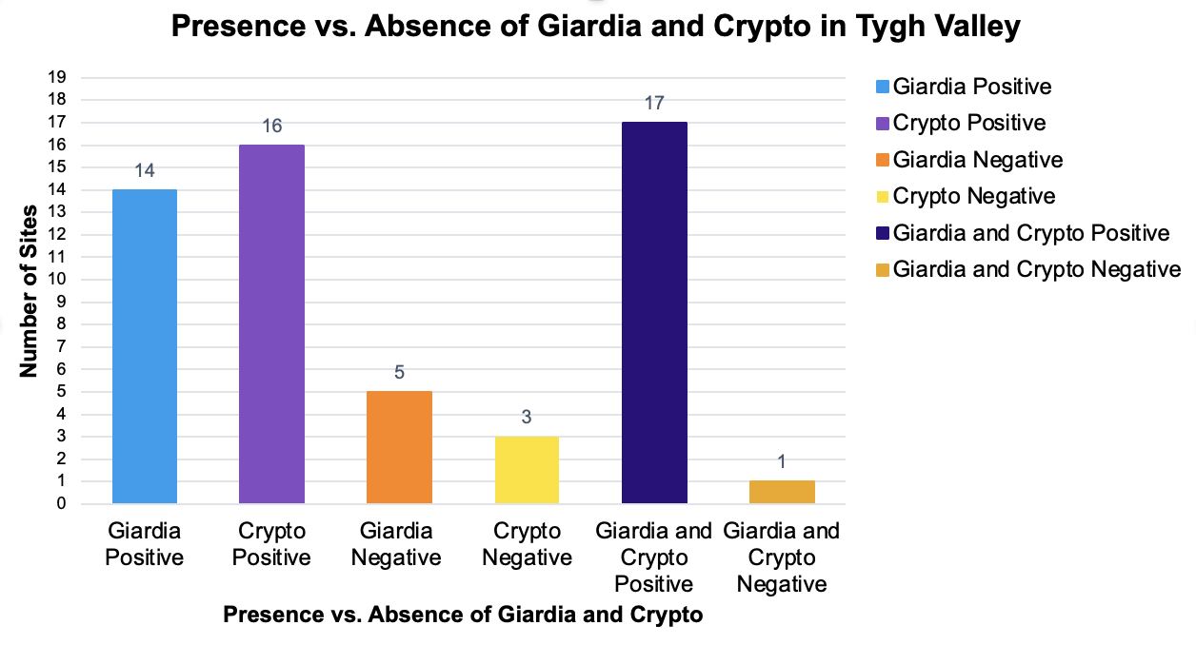
White River Watershed Merifluor Results
Presence vs. Absence of Giardia and Crypto in the White River Watershed
Notes:
17 White River watershed samples were positive for both Giardia and Crypto, 5 were negative for Giardia, 3 were negative for Crypto, 1 was positive for Giardia only, 3 were positive for Crypto only and only one site was negative for both as shown on the bar graph. (Try to calculate a percentage for the sites that had the highest number of crypto and both crypto and giardia.) ~84% were positive for crypto and ~90% were positive for both giardia and crypto.

Slide 30
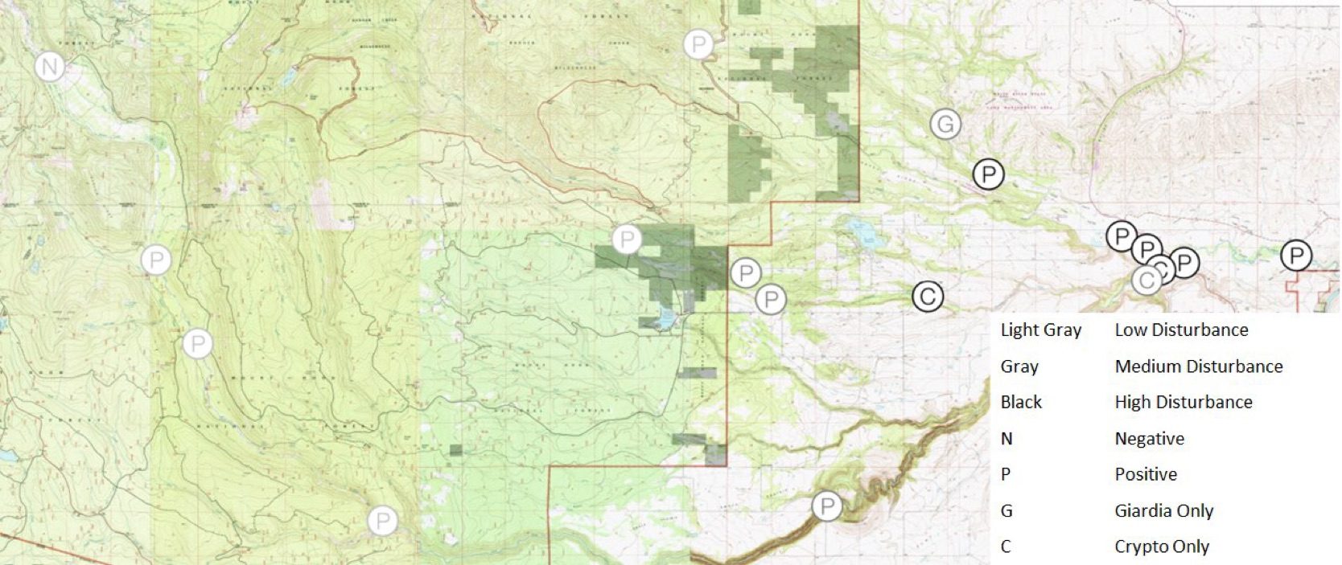
White River Watershed Merifluor Results
Notes:
The CALTOPO map shows these results while demonstrating where the low, medium, and high disturbance sites are located. The site negative for both was a low disturbance site and it was Highway 35 Site near Mt. Hood.

Slide 31
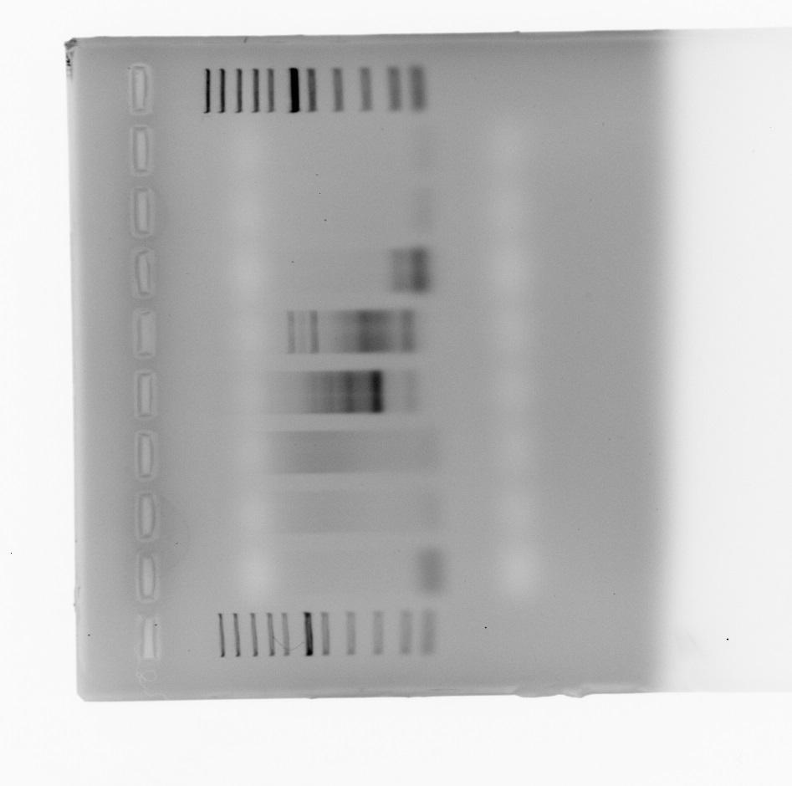
Waterborne Pathogens: Currently Working On…
Giardia Multilocus Genotyping of eDNA
18S ssuRNA
β-giardin (bg)
Triosephosphate isomerase (TPI)
Glutamate dehydrogenase (GDH)
Notes:
Danny
PCR and gel electrophoresis
What is multilocus genotyping?
Next gen sequencing- relative strain abundance
Mostly negative results for giardia, but positive on Merifluor? (In WRW)
Optimal temperature to run PCR
Prefilters?
Crypto- may do in future

Slide 32
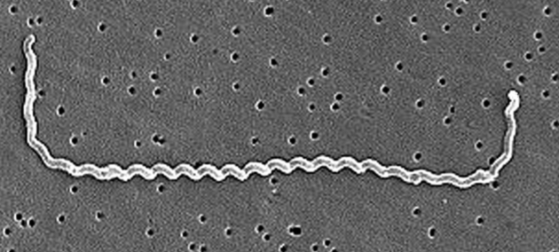
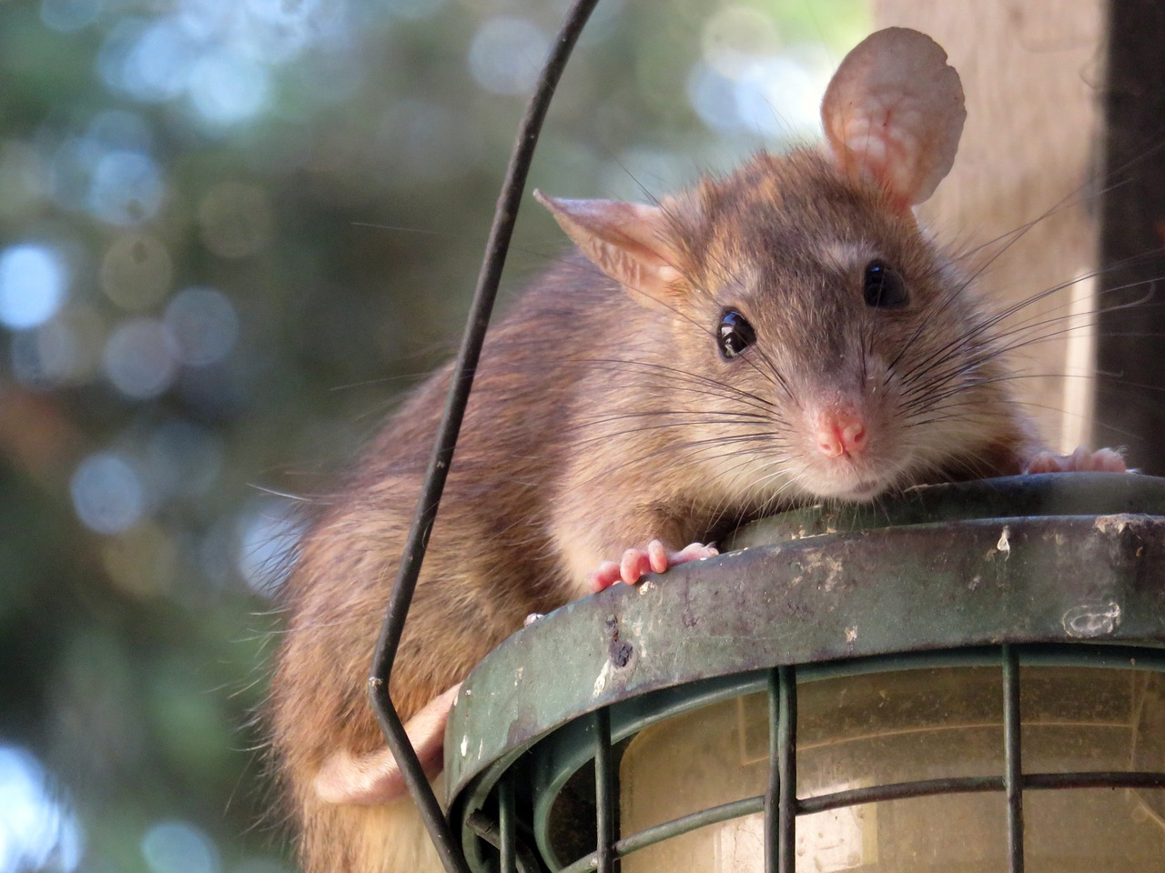
Waterborne Pathogens: Leptospira interrogans
Bacterial spirochete that causes liver and kidney damage
Zoonotic
  Many different reservoirs (mostly rodents)
  More than 200 pathogenic serovars
Tropical?
Notes:
Lepto & Giardia, Project “optimization” 3-5 min
Kacy
What: Bacterial parasite, most famously associated with Norway Rats, though more hosts exist.
Can cause variety of symptoms: fever, muscle pain, GI distress, jaundice, organ failure, meningitis
Zoonotic:
In rodents - minimal clinical effects (current research expanding on this)
Inhabit the renal tubules & shed into urine.
Pathogenic in many wild and domestic animals
Major cause of economic loss in the Meat & Dairy industry
In humans: Neglected Tropical Disease -WHO, close to 60k deaths a year worldwide.
Where:
Transmission through Contact with contaminated soil or water
Most infections associated with flood events.

Slide 33




Can Lepto be detected in environmental samples?
Does Lepto prevalence change with disturbance level?
Expected outcome: If found, it will be in the most disturbed sample locations.
Idexx Test results 2000-2014
Notes:
IT IS HERE, dogs/Sea lions incr. In prevalence.
Turns out the “neglected” issue is correlated with access to healthcare.

Slide 34





Waterborne Pathogens: Leptospira
Sample Preparation:
  Vacuum filtration of 1L surface water
  Extract DNA from Filter
Notoriously difficult to find in the environment
Detection by Digital Droplet PCR
Notes:
Lepto & Giardia, Project “optimization” 3-5 min
Kacy
Sample Preparation:
1L of water is filtered through multiple stages
Unlike the AMR: the entire filter is used to extract the eDNA
Modified QIAGEN DN-Easy Protocol
Digital Droplet PCR
Sample is fractionated into >25k droplets and individual PCR reactions occur in each droplet.
Primers used from VDL assay-
Graph to the right is from these samples.
Reaction Fluorescence is compared to the positive control to identify droplets with target DNA.

Slide 35

Waterborne Pathogens: Leptospira
Results:
1 Confirmed positive
11 Equivocal results
  5 from soil samples, 6 from water filters
Next steps:
Extraction of prefilters- Coffee and Gauze
Increase filtration volume
Enrichment
Notes:
Results:
Positive: OSU RAIL pond
11 results need confirmation by subsequent testing/ scrutiny.
The pathogen is so rare, detection in only 1-3 of the 25k droplets.
Next steps:
We are curious about Leptosipra attaching itself to substrates therefore, the prefilters are being extracted.
Most protocols use >5L of water per sample- we were only able to filter up to 1 L- sometimes substantially less due to water conditions
Most disturbed areas- higher likelihood of detection, lower filter ability.
Most protocols have an enrichment step- bumping up the numbers of any possible lepto for easier detection
Cause time delay
Changes the economics

Slide 36



Waterborne Pathogens: Summary
Cryptosporidium
  No effect of human land use on prevalence
  May include species analysis in the future
Giardia
  No effect of human land use on prevalence
  Currently research effect of human land use on strain diversity
  DNA extraction from pre-filters
  Experiment with annealing temperatures
Leptospira
  Low detections, protocol changes needed
  Filter higher volumes of water
  DNA extraction from pre-filters
Notes:
Lepto & Giardia, Project “optimization” 3-5 min
Danny/Kacy?
Remember to include conclusions or future work

Slide 37


Ticks
Ixodes pacificus
Lyme Disease
Anaplasma
Ehrlichia
Dermacentor variabilis
Rocky Mountain Spotted Fever (RMSF)
Rhipicephalus sanguineus
RMSF
Babesia
Ehrlichia
Notes:
TIcks: 5 min
Danny
There has been an increase in emergence of vector-borne pathogens worldwide. Land use is correlated with said rise, and is therefore worthwhile to study the affect land-use has on the prevalence of ticks and any zoonotic disease they may carry. In Oregon, there are primarily three types of ticks: Ixodes pacificus, which is a vector for lyme dz, anaplasma, and erlichia; Dermacentor variabilis (aka American Dog Tick), a vector for rocky mountain spotted fever (RMSF); and Rhipicephalus sanguineus (aka Brown Dog Tick), a vector for RMSF, babesia, and erlichia

Slide 38
Ticks: Objective of Study
Determine tick prevalence in Oregon, and does tick abundance change over a land use gradient from low to high disturbance?

Slide 39


Ticks: Methods
Notes:
We sampled the surrounding land of our water sample sites by dragging a cloth in 50 foot transect. Ticks would land on the cloth as it passes by and we would collect the ticks after every transect. Transects were kept as consistent as possible, because prevalence is determined by the number of ticks in a given area. Any collected ticks were identified as Ixodes, Dermacenter, or Rhiphicephalus under a microscope, and whether they were adults, nymphs, or larvae, male or female. Ticks were then pooled based on sample site, sex, species, and life stage, and submitted to the oregon state veterinary diagnostic laboratory to test to see if they carried any of their respective diseases.

Slide 40


Ticks: Results
% of Disturbance Types with Ticks
White River Watershed Tick Abundance
Mary’s River
White River Watershed
Notes:
TIcks: 5 min
Danny
We did not find any ticks along the Mary’s river. Along the white river watershed, we only discovered ticks in 4 out of 15 sites. All ticks collected were Dermacentor variabilis, and therefore were only tested for RMSF. Only 1 sample site was positive for RMSF, which was a low disturbance site. We found a greater abundance of ticks at medium disturbance sites than at high or low disturbance sites. However, it should be noted that sample size was very small, and sample size and area were limited and variable due to sampling location being chosen primarily for water sampling.

Slide 41


Ticks: Plan going forward
Choosing Sample Sites
Sample during more active season
Standardize collection methods
Rocky Mountain Spotted Fever!
Notes:
TIcks: 5 min
Danny
Choose sample sites primary for collecting ticks to get a more consistent area between sites for accurate tick surveillance. As you can see we were limited in some instances to fit transects in narrow areas or along roads. We sampled in July, whereas ticks are more active in the springtime. Changing the season that we sample may yield better results. An alternative to the drag cloth sampling method, using dry ice to attract ticks (as they are attracted to carbon dioxide) may also yield better results in future studies. In conclusion, only 4 out of 15 sample sites in the white river watershed had ticks, and only 1 site tested positive for a tick borne dz: rocky mountain spotted fever.

Slide 42

One Health is a transdisciplinary, collaborative approach to public health based on recognizing the interconnection between people, animals, plants, and their shared environment.
Notes:
Conclusions: 3-5 min
Justin

Slide 43

Notes:
Conclusions: 3-5 min
Justin

Slide 44




Educational Outcomes: Collaborating
Developed sampling plans, collection, & analytical methods
Notes:
Bench/classroom to the field; Ongoing refinement once back in the lab

Slide 45


Educational Outcomes: Coordinating
Planned & executed field research in two regions
Notes:
setting up mobile laboratory; access to sites, coordinating with landowners, dynamic conditions in the field req adjustment of plans and protocols

Slide 46






Educational Outcomes & Student Success: Communicating
Presentations so far…
Mariangel - OSU Summer Undergraduate Research Symposium
Gabriela - SACNAS National Diversity in STEM Conference, Puerto Rico; 1 addt’l abstract submitted to SACNAS for April
Alexis & Michelle - WU Student Technology & Research Symposium (Michelle’s abstract won an award!)
Natalie - Presenting at COMP-NW Annual Research Symposium, Dec. 14th
Alexis & Michelle with OSU Veterinary Students presenting at the National Veterinary Scholars Symposium, Minneapolis, MN, August 2022.
Notes:
Work has been/will be presented 8 times

Slide 47




Acknowledgements
Tygh Valley:
Kate Willis, Dan van Lehman
Justesen Ranch, Elizabeth Unti, Delayne Delco, Zach Harvey
Hilary and Joe Jensen
Mike and Laila Davis
Mary Beechler
Marys River:
Starker Forests
Crestmont Land Trust
Corvallis Parks & Recreation Dept
Herb (no last name given)
Dave Newman & company
Harris Bridge Winery
Funding provided by CCVM Biomedical Sciences and a grant from Western University of Health Sciences (to R. Hanselmann)
Notes:
-Landowners that allowed access to their land/water along the White River:Kate Willis, Dan van Lehman, Justesen Ranch, Elizabeth Unti, Delayne Delco, Zach Harvey
-Assistance is accessing the Justesen land on the White River - Hilary & Joe
-providing discounted housing for students in Tygh Valley: Mike and Laila Davis

Slide 48
Opportunities 2023
June 26th-August 4th
Opportunities for OSU undergraduate students, OSU veterinary students, OSU MPH students to participate in the program
  Stipends available of 2k for undergraduate students, 3k for graduate students
  Apply through OSU summer biomedical sciences program - applications due in January
    Vet students: Biomedical Sciences Summer Program For Students | Carlson College of Veterinary Medicine
    Undergraduates: Summer Undergraduate Research Program | Carlson College of Veterinary Medicine

Slide 49

Questions

